Slide 1

Advanced Programming CMP 102
Dr. Perihan PEHLİVANOĞLU
Biruni Univarsity
Department of Computer Engineering 2023
Spring

Slide 2
Course Plan
Introduction - Functions (Recursive functions) Arrays, ArrayList, Vector
Collections (List, Queue, Stack, Set, Map, Tree)
Streams, Files
Generics and Exceptions
Midterm Exam

Slide 3
Course Plan
Visual Programming Fundamentals Designing a Form Controls and Forms Properties of Components and Events Final Exam

Slide 4

Last Lecture
JavaFX examples.

Slide 5
Motivation
In this lecture, we will focus on Example programs in visual programming in Java. We will use Scene Builder.

Slide 6
JavaFX Program Structure

Slide 7
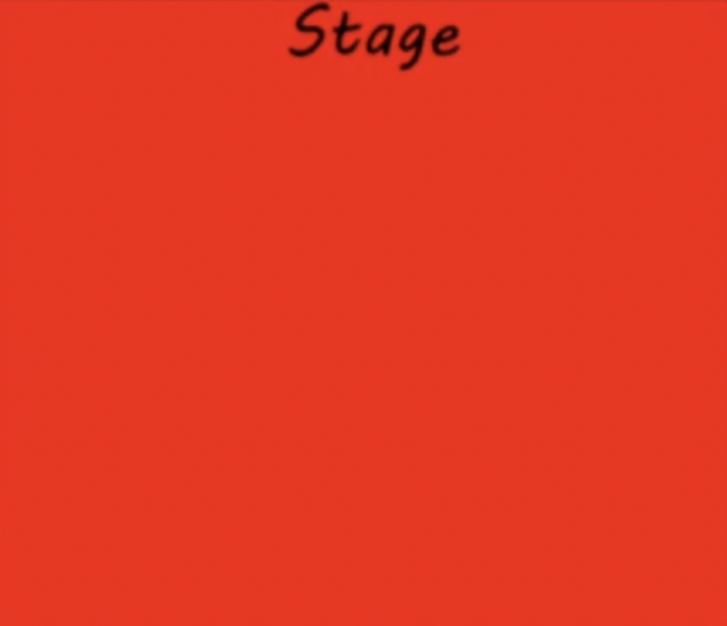
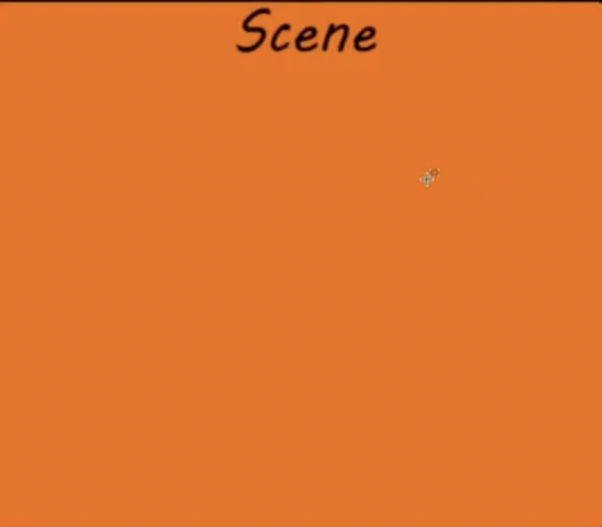
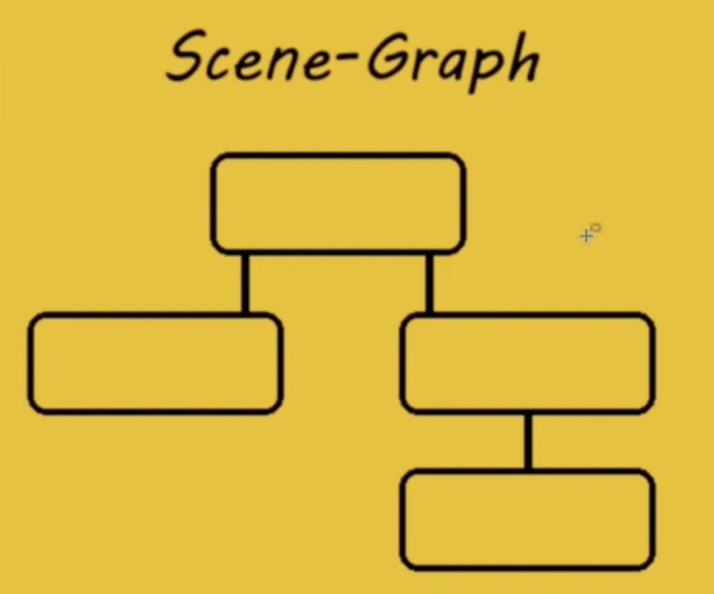
JavaFX Program
Consists of Stage, Scene and nodes.

Slide 8
The Basic Structure of a JavaFX Program
JavaFX is a modern graphical user interface (GUI) framework for creating desktop and mobile applications. The program structure of a JavaFX application consists of the following components:
Application class: This is the entry point of the JavaFX application, which extends the javafx.application.Application class. It contains the main() method, which launches the application.
Stage class: A stage represents a top-level container or window of a JavaFX application. The stage is created in the start() method of the Application class.
Scene class: A scene represents the content of a stage, which is defined using the javafx.scene.Scene class. A scene can contain one or more nodes, such as buttons, text fields, labels, and images.
Layouts: JavaFX provides various layout classes to arrange nodes in the scene, such as VBox, HBox, BorderPane, GridPane, and FlowPane. These layouts help to organize the user interface elements in a structured manner.
Nodes: Nodes are the graphical components that are placed inside the scene, such as buttons, text fields, labels, and images. Each node is an instance of a class that extends the javafx.scene.Node class.
Event handling: JavaFX provides a comprehensive event handling mechanism to handle user interactions, such as button clicks, mouse movements, and key presses. Event handling is done using the EventHandler interface and the setOn<ActionEvent>() method.
CSS styling: JavaFX supports CSS styling for styling the user interface elements. You can use CSS to define the color, font, size, and layout of the nodes in the scene.
In summary, the program structure of a JavaFX application consists of the Application class, Stage class, Scene class, Layouts, Nodes, Event handling, and CSS styling.

Slide 9
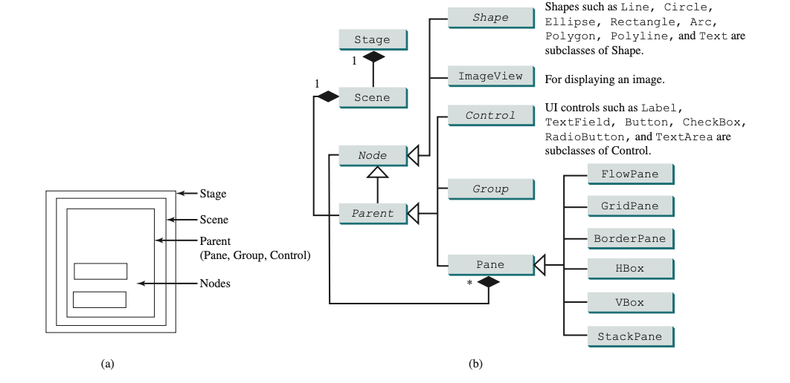
Pane, Group, UI Control, Shape
Their relationships with each other.

Slide 10
JavaFX Program
New class, extends Application.
public class MyJavaFX extends Application { }
The class has a start method. It must end with the .show() method to display the added visual programming components.
public void start(Stage primaryStage)
{ primaryStage.show(); }
The Main method has only one code in it.
public static void main(String[] args) {
launch(args);
}

Slide 11
Java FX UI Controls
You can add controls to a form that you create with Java FX User Interface Controls.
Label
Button
Radio Button
Toggle Button
Checkbox
Choice Box
Text Field
Password Field
Scroll Bar
Scroll Pane
List View
Table View
Tree View
Tree Table View
Combo Box
Separator
Slider
Progress Bar and Progress Indicator
Hyperlink
Tooltip
HTML Editor
Titled Pane and Accordion
Menu
Color Picker
Date Picker
Pagination Control
File Chooser
Customization of UI Controls
UI Controls on the Embedded Platforms

Slide 12
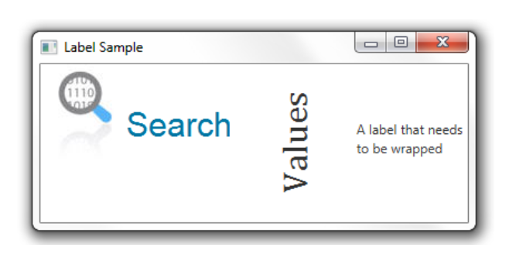
Label
Label is in the javafx.scene.control library and is used to add the text element to forms. The image shows 3 uses of the label control. The setText() method is used to add text to the label.
//An empty label
Label label1 = new Label();
//A label with the text element
Label label2 = new Label("Search");
//A label with the text element and graphical icon
Image image = new Image(getClass().getResourceAsStream("labels.jpg")); Label label3 = new Label("Search", new ImageView(image));
Label label1 = new Label("Search");
Image image = new Image(getClass().getResourceAsStream("labels.jpg"));
label1.setGraphic(new ImageView(image));
label1.setTextFill(Color.web("#0076a3"));

Slide 13
Label
You can change the font of the Label.
//Use a constructor of the Font class
Label label1, label2;
label1.setFont(new Font("Arial", 30));
//Use the font method of the Font class
label2.setFont(Font.font("Cambria", 32));
Label label3 = new Label("A label that needs to be wrapped");
label3.setWrapText(true);

Slide 14
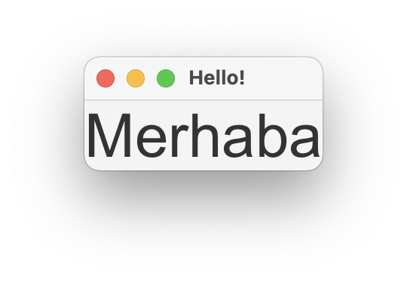
Visual Program Example - 1
Label kullanarak Visual program hazırlayalım.

Slide 15
Label Programı
package com.example.kontrollerprj1;
import javafx.application.Application;
import javafx.fxml.FXMLLoader;
import javafx.scene.Scene;
import javafx.scene.control.Label;
import javafx.scene.layout.AnchorPane;
import javafx.scene.text.Font;
import javafx.stage.Stage;
import java.io.IOException;
public class HelloApplication extends Application {
@Override
public void start(Stage stage) throws IOException {
AnchorPane root = new AnchorPane();
Scene scene = new Scene(root);
Label etiket = new Label ("Merhaba");
etiket.setFont(Font.font("Arial",40));
root.getChildren().add(etiket);
stage.setTitle(“Hello!");
stage.setScene(scene);
stage.show();
}
public static void main(String[] args) {
launch();
}
}

Slide 16
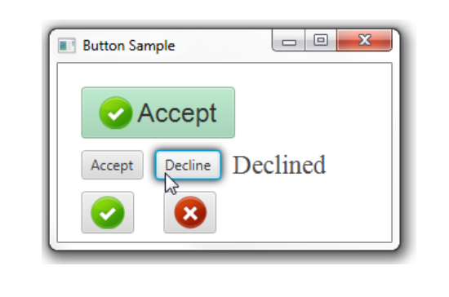
Button
Button, düğme elemanını formlara eklemek için kullanılır. Visualde düğme kontrolünün kullanımı gösterilmektedir. setText() ile buton’a caption ekleyebilirsiniz.
//A button with an empty text caption.
Button button1 = new Button();
//A button with the specified text caption.
Button button2 = new Button("Kabul");
//A button with the specified text caption and icon.
Image imageOk = new Image(getClass().getResourceAsStream(“ok.png"));
Button button3 = new Button("Accept", new ImageView(imageOk));

Slide 17
Button
Button’a tıkladığınızda aşağıdaki şekilde action ekleyebilirsiniz.
button2.setOnAction((ActionEvent e)
{ label.setText("Accepted");
}

Slide 18
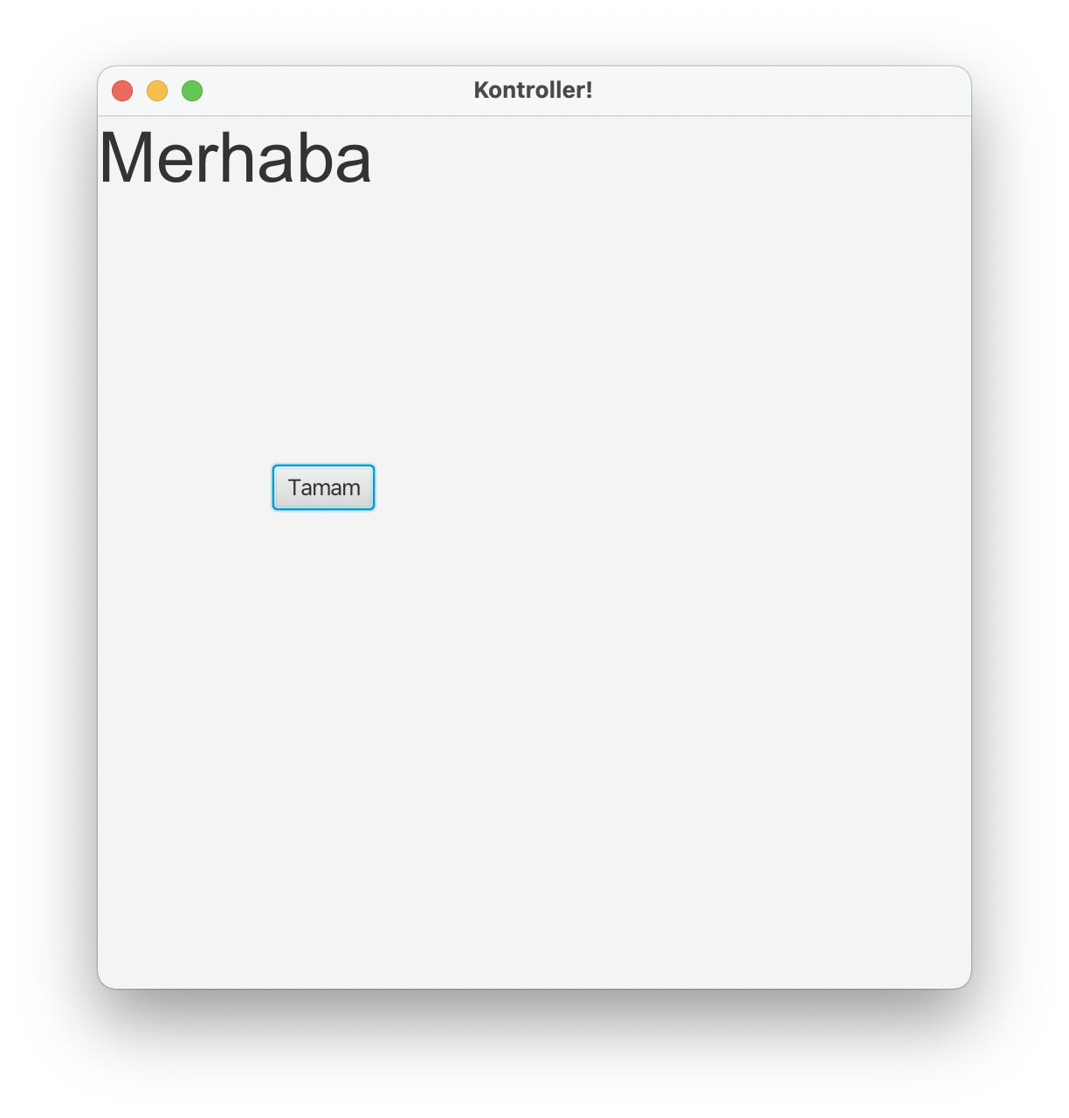
Visual Program Example - 2
Implement a Visual program using Label.

Slide 19
Button Program
package com.example.kontrollerprj1;
import javafx.application.Application;
import javafx.fxml.FXMLLoader;
import javafx.scene.Scene;
import javafx.scene.control.Button;
import javafx.scene.control.Label;
import javafx.scene.image.Image;
import javafx.scene.image.ImageView;
import javafx.scene.layout.AnchorPane;
import javafx.scene.text.Font;
import javafx.stage.Stage;
import java.io.IOException;
public class HelloApplication extends Application {
@Override
public void start(Stage stage) throws IOException {
AnchorPane root = new AnchorPane();
Scene scene = new Scene(root, 500,500);
Label etiket = new Label ("Merhaba");
etiket.setFont(Font.font("Arial",40));
root.getChildren().add(etiket);
Button dugme = new Button("Tamam");
dugme.setLayoutX(100);
dugme.setLayoutY(200);
root.getChildren().add(dugme);
stage.setTitle("Kontroller!");
stage.setScene(scene);
stage.show();
}
public static void main(String[] args) {
launch();
}
}

Slide 20
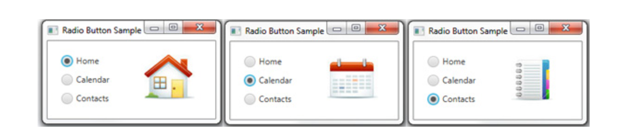
Radio Button
Radio Button kontrolü seçim için kullanılır. Gruplanarak grup içinde sadece bir tanesinin seçimi sağlanabilir.
Bir radio button’ı seçmek için setSelected() metodu ile true yapılır. Seçilip seçilmediğini kontrol için isSelected() metodu kullanılır.
//A radio button with an empty string for its label
RadioButton rb1 = new RadioButton();
//Setting a text label
rb1.setText("Home");
//A radio button with the specified label
RadioButton rb2 = new RadioButton("Calendar");
Image image = new Image(getClass().getResourceAsStream(“/ok.jpg"));
rb2.setGraphic(new ImageView(image));

Slide 21
Radio Button
Radio Buttonlar grubunda sadece 1 tane radio button’ın seçilmesini sağlamak için gruplamak gerekiyor.

Slide 22
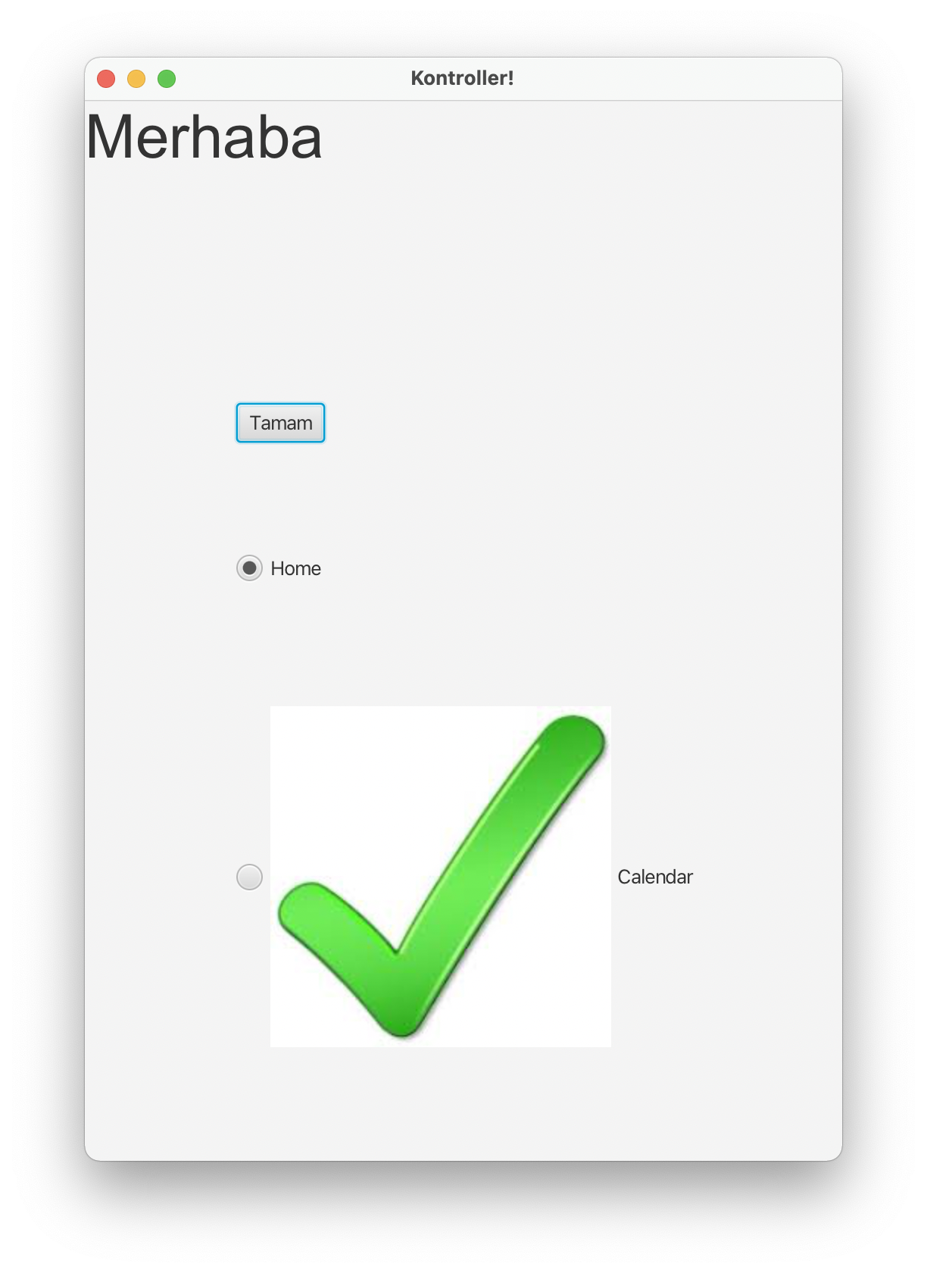
Visual Program Example - 3
Radio button kullanarak Visual program hazırlayalım.

Slide 23
Radio Button Program
package com.example.kontrollerprj1;
import javafx.application.Application;
import javafx.fxml.FXMLLoader;
import javafx.scene.Parent;
import javafx.scene.Scene;
import javafx.scene.control.Button;
import javafx.scene.control.Label;
import javafx.scene.control.RadioButton;
import javafx.scene.control.ToggleGroup;
import javafx.scene.image.Image;
import javafx.scene.image.ImageView;
import javafx.scene.layout.AnchorPane;
import javafx.scene.text.Font;
import javafx.stage.Stage;
import java.io.IOException;
public class HelloApplication extends Application {
@Override
public void start(Stage stage) throws IOException {
AnchorPane root = new AnchorPane();
Scene scene = new Scene(root, 500,700);
Label etiket = new Label ("Merhaba");
etiket.setFont(Font.font("Arial",40));
root.getChildren().add(etiket);
Button dugme = new Button("Tamam");
dugme.setLayoutX(100);
dugme.setLayoutY(200);
dugme.setFont(Font.font("Calibri"));
root.getChildren().add(dugme);
//A radio button with an empty string for its label
RadioButton rb1 = new RadioButton();
//Setting a text label
rb1.setText("Home");
//A radio button with the specified label
RadioButton rb2 = new RadioButton("Calendar");
rb1.setLayoutX(100);
rb1.setLayoutY(300);
rb2.setLayoutX(100);
rb2.setLayoutY(400);
Image image = new Image(getClass().getResourceAsStream("/ok.jpg"));
rb2.setGraphic(new ImageView(image));
final ToggleGroup group = new ToggleGroup();
rb1.setToggleGroup(group);
rb1.setSelected(true);
rb2.setToggleGroup(group);
root.getChildren().add(rb1);
root.getChildren().add(rb2);
stage.setTitle("Kontroller!");
stage.setScene(scene);
/* Parent root = FXMLLoader.load(getClass().getResource("hello-view.fxml"));
Scene scene = new Scene(root, 600,600);
stage.setScene(scene);
*/
stage.show();
}
public static void main(String[] args) {
launch();
}
}

Slide 24
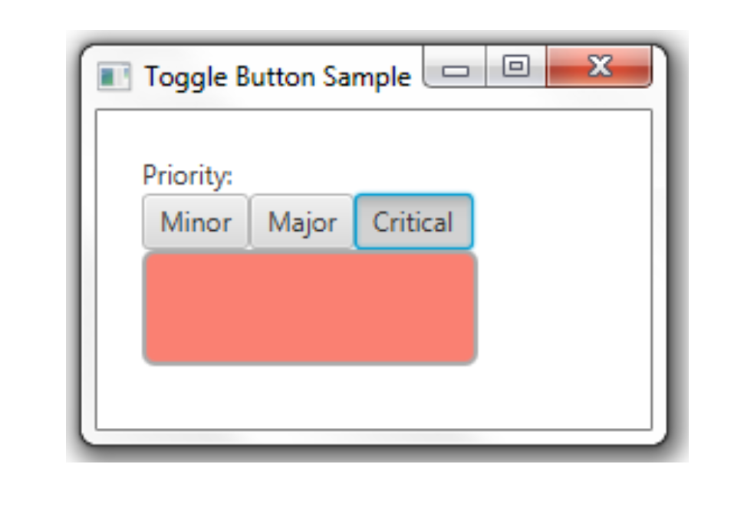
Toggle Button
Multiple buttons can be grouped, allowing only one to be selected.
//A toggle button without any caption or icon
ToggleButton tb1 = new ToggleButton();
//A toggle button with a text caption
ToggleButton tb2 = new ToggleButton("Press me");
//A toggle button with a text caption and an icon
Image image = new Image(getClass().getResourceAsStream("/ok.jpg"));
ToggleButton tb3 = new ToggleButton ("Press me", new ImageView(image));

Slide 25
Toggle Button
In the Toggle Buttons group, it is necessary to group only 1 toggle button to ensure that it is selected.

Slide 26
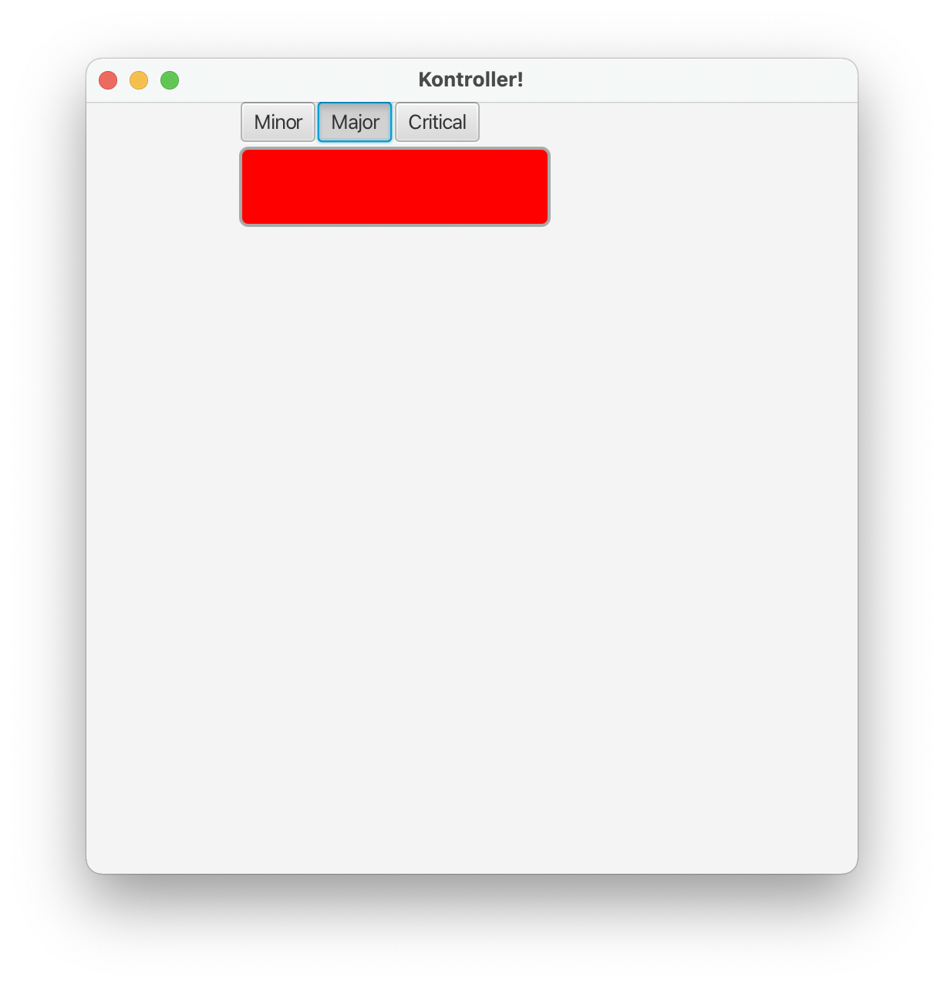
Visual Program Example - 4
Implement a Visual program using the Toggle button.

Slide 27
Toggle Button Program
package com.example.kontrollerprj1;
import javafx.application.Application;
import javafx.fxml.FXMLLoader;
import javafx.scene.Parent;
import javafx.scene.Scene;
import javafx.scene.control.*;
import javafx.scene.image.Image;
import javafx.scene.image.ImageView;
import javafx.scene.layout.AnchorPane;
import javafx.scene.paint.Color;
import javafx.scene.shape.Rectangle;
import javafx.scene.text.Font;
import javafx.stage.Stage;
import java.io.IOException;
public class HelloApplication extends Application {
@Override
public void start(Stage stage) throws IOException {
AnchorPane root = new AnchorPane();
Scene scene = new Scene(root, 500,500);
final ToggleGroup group = new ToggleGroup();
ToggleButton tb1 = new ToggleButton("Minor");
tb1.setToggleGroup(group);
tb1.setSelected(true);
ToggleButton tb2 = new ToggleButton("Major");
tb2.setToggleGroup(group);
ToggleButton tb3 = new ToggleButton("Critical");
tb3.setToggleGroup(group);
tb1.setLayoutX(100);
tb2.setLayoutX(150);
tb3.setLayoutX(200);
tb1.setUserData(Color.LIGHTGREEN);
tb2.setUserData(Color.LIGHTBLUE);
tb3.setUserData(Color.SALMON);
Rectangle rect = new Rectangle();
rect.setLayoutX(100);
rect.setHeight(50);
rect.setLayoutY(30);
rect.setWidth(200);
rect.setFill(Color.RED);
rect.setStroke(Color.DARKGRAY);
rect.setStrokeWidth(2);
rect.setArcHeight(10);
rect.setArcWidth(10);
root.getChildren().add(tb1);
root.getChildren().add(tb2);
root.getChildren().add(tb3);
root.getChildren().add(rect);
stage.setTitle("Kontroller!");
stage.setScene(scene);
/* Parent root = FXMLLoader.load(getClass().getResource("hello-view.fxml"));
Scene scene = new Scene(root, 600,600);
stage.setScene(scene);
*/
stage.show();
}
public static void main(String[] args) {
launch();
}
}

Slide 28
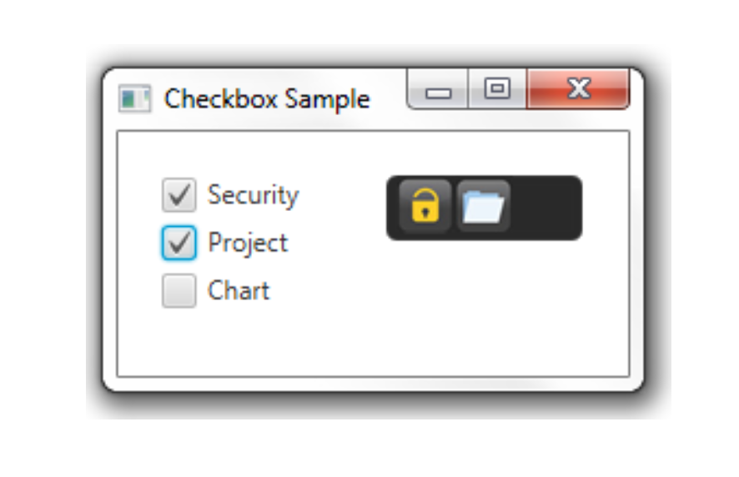
Checkbox
Although checkboxes are similar to radio buttons, only one cannot be selected by grouping.

Slide 29
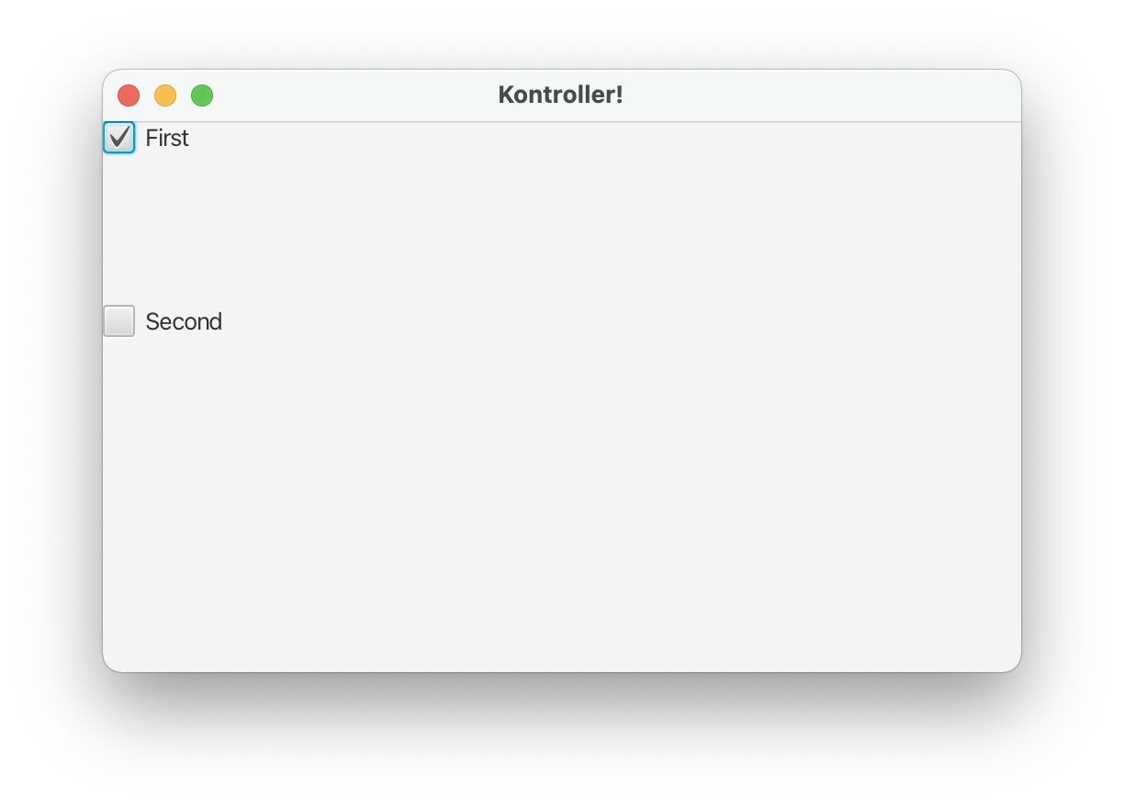
Visual Program Example - 5
Implement a Visual program using a checkbox.

Slide 30
Checkbox Program
package com.example.kontrollerprj1;
import javafx.application.Application;
import javafx.fxml.FXMLLoader;
import javafx.scene.Parent;
import javafx.scene.Scene;
import javafx.scene.control.*;
import javafx.scene.image.Image;
import javafx.scene.image.ImageView;
import javafx.scene.layout.AnchorPane;
import javafx.scene.paint.Color;
import javafx.scene.shape.Rectangle;
import javafx.scene.text.Font;
import javafx.stage.Stage;
import java.io.IOException;
public class HelloApplication extends Application {
@Override
public void start(Stage stage) throws IOException {
AnchorPane root = new AnchorPane();
Scene scene = new Scene(root, 500,500);
//A checkbox CheckBox cb1 without a caption
CheckBox cb1= new CheckBox();
// A checkbox CheckBox cb2 with a string caption
CheckBox cb2 = new CheckBox("Second");
cb1.setText("First");
cb1.setSelected(true);
cb2.setLayoutY(100);
root.getChildren().add(cb1);
root.getChildren().add(cb2);
stage.setTitle("Kontroller!");
stage.setScene(scene);
stage.show();
}
public static void main(String[] args) {
launch();
}
}

Slide 31
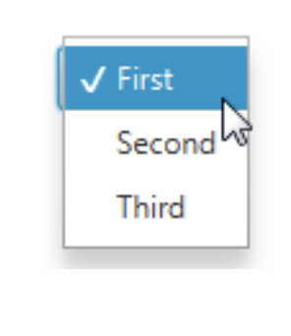
Choicebox
Choiceboxes allow you to select elements from a list.
ChoiceBox cb = new ChoiceBox(); cb.setItems(FXCollections.observableArrayList(
"New Document", "Open ",
new Separator(), "Save", "Save as") );

Slide 32
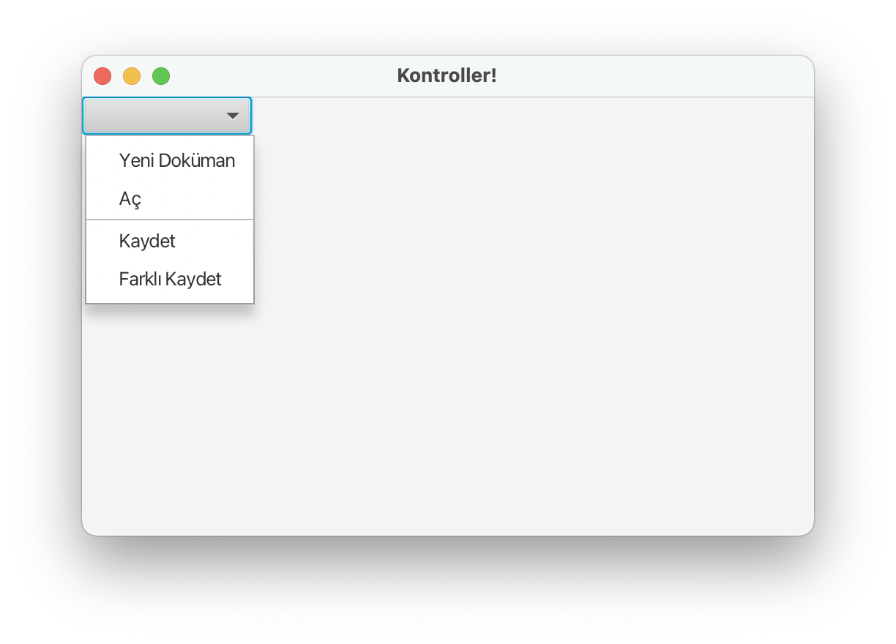
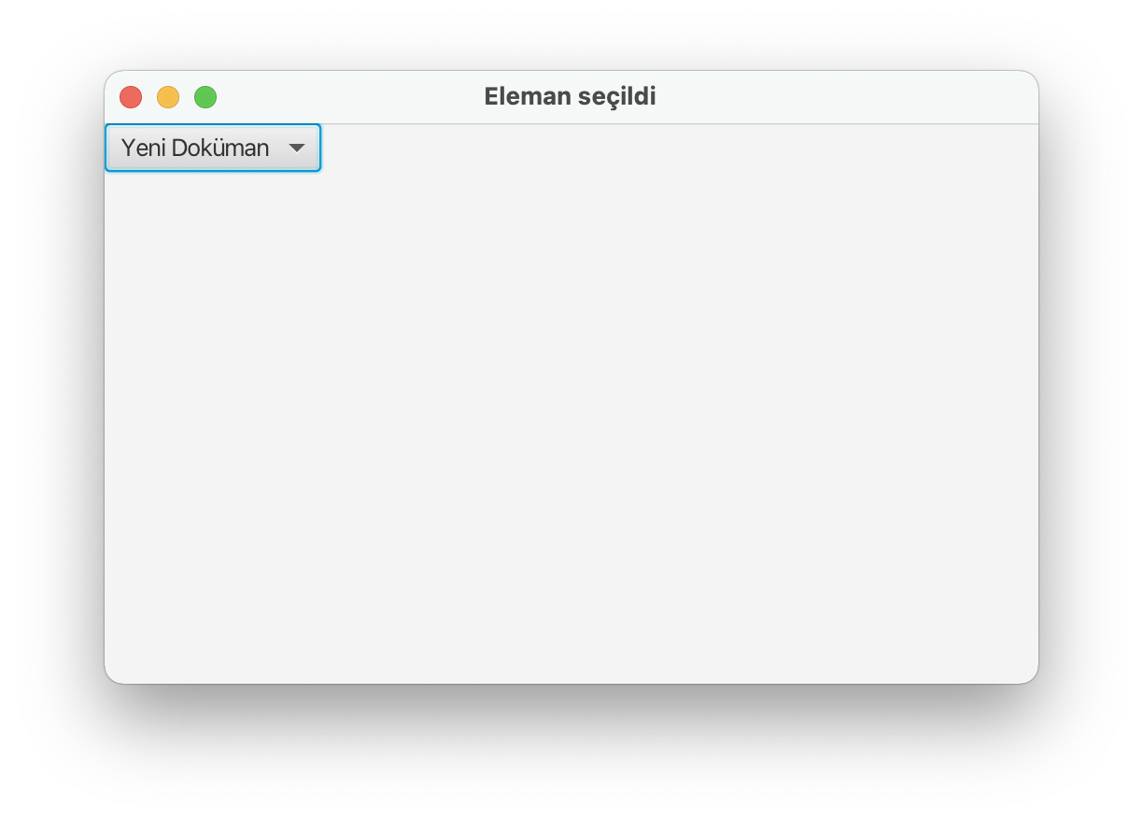
Visual Program Example - 6
Implement a Visual program using Choicebox.

Slide 33
Choicebox Program
package com.example.kontrollerprj1;
import javafx.application.Application;
import javafx.beans.value.ObservableValue;
import javafx.collections.FXCollections;
import javafx.fxml.FXMLLoader;
import javafx.scene.Parent;
import javafx.scene.Scene;
import javafx.scene.control.*;
import javafx.scene.image.Image;
import javafx.scene.image.ImageView;
import javafx.scene.layout.AnchorPane;
import javafx.scene.paint.Color;
import javafx.scene.shape.Rectangle;
import javafx.scene.text.Font;
import javafx.stage.Stage;
import java.io.IOException;
public class HelloApplication extends Application {
@Override
public void start(Stage stage) throws IOException {
AnchorPane root = new AnchorPane();
Scene scene = new Scene(root, 500,300);
ChoiceBox cb1=new ChoiceBox();
cb1.setItems(FXCollections.observableArrayList("Yeni Doküman", "Aç", new Separator(),"Kaydet", "Farklı Kaydet"));
cb1.getSelectionModel().selectedIndexProperty().addListener(
(ObservableValue<? extends Number> ov, Number old_val, Number new_val) -> { stage.setTitle("Eleman seçildi");});
root.getChildren().add(cb1);
stage.setTitle("Kontroller!");
stage.setScene(scene);
stage.show();
}
public static void main(String[] args) {
launch();
}
}

Slide 34
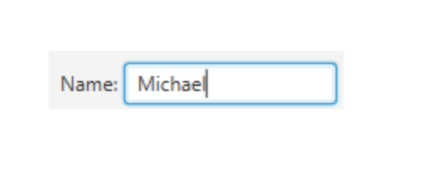
Textfield
You can read the input with the textfield.
Label label1 = new Label("Adınız:");
TextField textField = new TextField ();
HBox hb = new HBox();
hb.getChildren().addAll(label1, textField);
hb.setSpacing(10);
root.getChildren().add(hb);

Slide 35
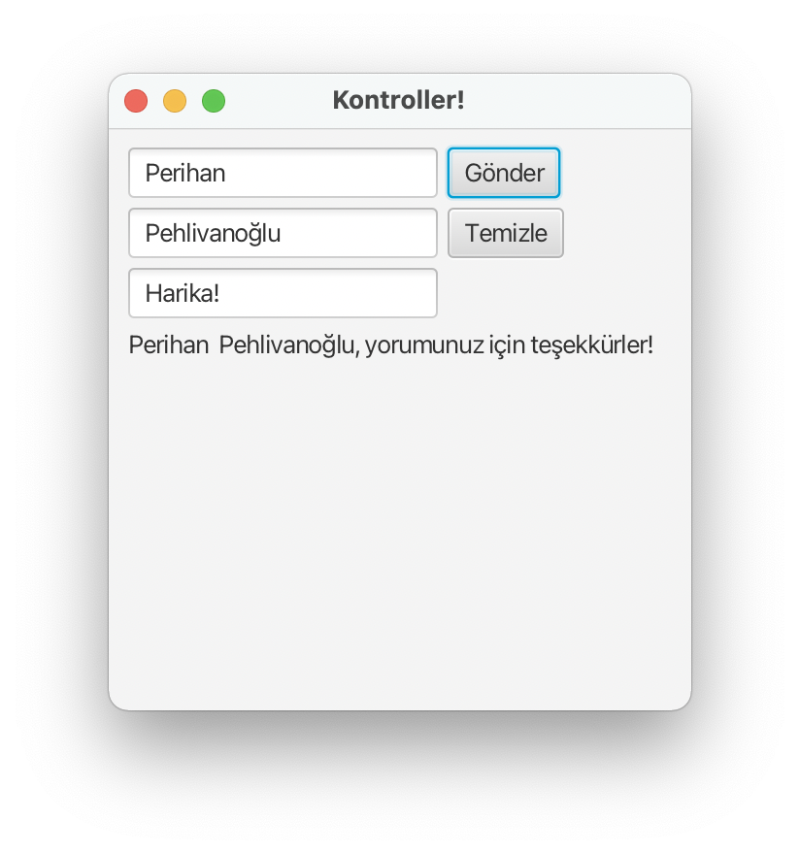
Visual Program Example - 7
Implement a Visual program using a textfield.

Slide 36
Textfield Program
package com.example.kontrollerprj1;
import javafx.application.Application;
import javafx.event.ActionEvent;
import javafx.geometry.Insets;
import javafx.scene.Scene;
import javafx.scene.control.*;
import javafx.scene.layout.GridPane;
import javafx.scene.layout.HBox;
import javafx.scene.paint.Color;
import javafx.scene.text.Font;
import javafx.stage.Stage;
import java.io.IOException;
public class HelloApplication extends Application {
@Override
public void start(Stage stage) throws IOException {
GridPane root = new GridPane();
root.setPadding(new Insets(10, 10, 10, 10));
root.setVgap(5);
root.setHgap(5);
//Defining the Name text field
final TextField ad = new TextField();
ad.setPromptText("Adınızı giriniz.");
GridPane.setConstraints(ad, 0, 0);
root.getChildren().add(ad);
//Defining the Last Name text field
final TextField soyad = new TextField();
soyad.setPromptText("Soyadınızı giriniz.");
GridPane.setConstraints(soyad, 0, 1);
root.getChildren().add(soyad);
//Defining the Comment text field
final TextField yorum = new TextField();
yorum.setPromptText("Yorumunuz.");
GridPane.setConstraints(yorum, 0, 2);
root.getChildren().add(yorum);
//Defining the Submit button
Button gonder = new Button("Gönder");
GridPane.setConstraints(gonder, 1, 0);
root.getChildren().add(gonder);
//Defining the Clear button
Button temizle = new Button("Temizle");
GridPane.setConstraints(temizle, 1, 1);
root.getChildren().add(temizle);
stage.setTitle("Kontroller!");
Scene scene = new Scene(root,300,300);
stage.setScene(scene);
//Adding a Label
final Label label = new Label(); GridPane.setConstraints(label, 0, 3);
GridPane.setColumnSpan(label, 2);
root.getChildren().add(label);
gonder.setOnAction((ActionEvent e) -> { if(
(yorum.getText() != null && !yorum.getText().isEmpty()) ){
label.setText(ad.getText() + " " + soyad.getText() + ", "
+ "yorumunuz için teşekkürler!");
}else{
label.setText("Bir yorum yapmadınız.");
} });
temizle.setOnAction((ActionEvent e) -> { ad.clear();
soyad.clear(); yorum.clear(); label.setText(null);
});
stage.show();
}
public static void main(String[] args) {
launch();
}
}

Slide 37
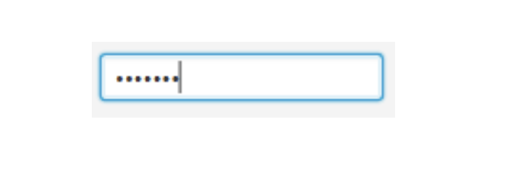
Password Field
You can read the password with the password field.
PasswordField passwordField = new PasswordField();
passwordField.setPromptText("Şifreniz");

Slide 38
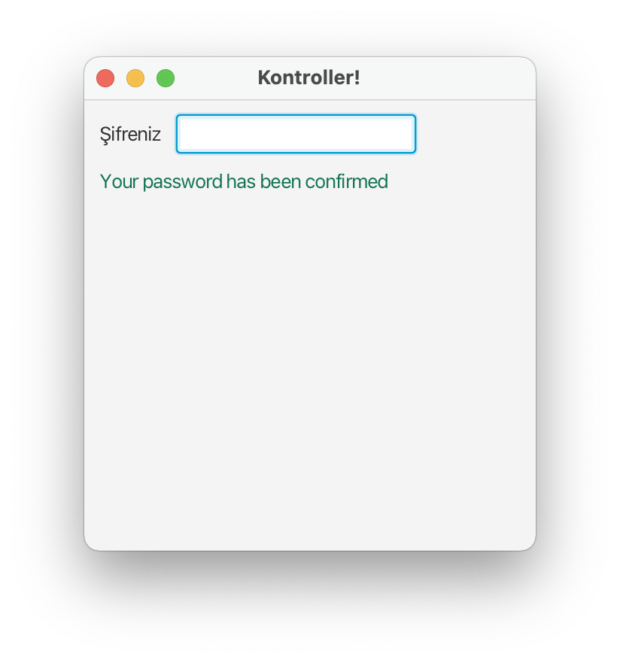
Visual Program Example - 8
Implement a Visual program using Password.

Slide 39
Password Program
package com.example.kontrollerprj1;
import javafx.application.Application;
import javafx.event.ActionEvent;
import javafx.geometry.Insets;
import javafx.geometry.Pos;
import javafx.scene.Scene;
import javafx.scene.control.*;
import javafx.scene.layout.GridPane;
import javafx.scene.layout.HBox;
import javafx.scene.layout.VBox;
import javafx.scene.paint.Color;
import javafx.scene.text.Font;
import javafx.stage.Stage;
import java.io.IOException;
public class HelloApplication extends Application {
@Override
public void start(Stage stage) throws IOException {
final Label message = new Label("");
VBox vb = new VBox();
vb.setPadding(new Insets(10, 0, 0, 10));
vb.setSpacing(10);
HBox hb = new HBox();
hb.setSpacing(10);
hb.setAlignment(Pos.CENTER_LEFT);
stage.setTitle("Kontroller!");
Scene scene = new Scene(vb,300,300);
Label label = new Label("Şifreniz");
PasswordField pb = new PasswordField();
pb.setOnAction((ActionEvent e) -> {
if (!pb.getText().equals("AA")) {
message.setText("Your password is incorrect!");
message.setTextFill(Color.rgb(210, 39, 30)); }else{
message.setText("Your password has been confirmed");
message.setTextFill(Color.rgb(21, 117, 84)); }
pb.clear(); });
vb.getChildren().addAll(hb, message);
hb.getChildren().addAll(label, pb);
stage.setScene(scene);
stage.show();
}
public static void main(String[] args) {
launch();
}
}

Slide 40
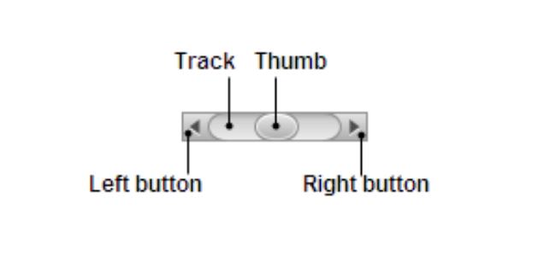
Scroll Bar
You can add visuality to your programs with scroll bar.

Slide 41
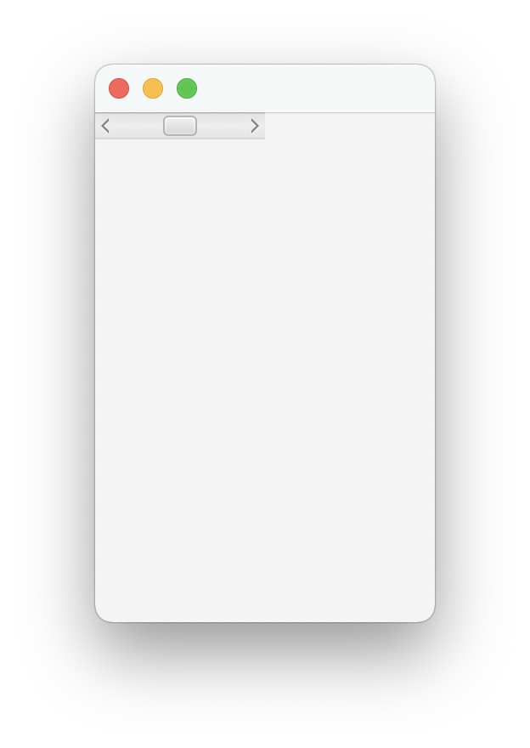
Visual Program Example - 9
Let’s implement a Visual program using the Scroll Bar.

Slide 42
Scroll Bar Program
package com.example.kontrollerprj1;
import javafx.application.Application;
import javafx.scene.Scene;
import javafx.scene.control.*;
import javafx.scene.layout.AnchorPane;
import javafx.stage.Stage;
import java.io.IOException;
public class HelloApplication extends Application {
@Override
public void start(Stage stage) throws IOException {
AnchorPane root = new AnchorPane();
ScrollBar sc = new ScrollBar();
sc.setMin(0);
sc.setMax(100);
sc.setValue(50);
Scene scene = new Scene(root, 200,300);
root.getChildren().add(sc);
stage.setScene(scene);
stage.show();
}
public static void main(String[] args) {
launch();
}
}

Slide 43
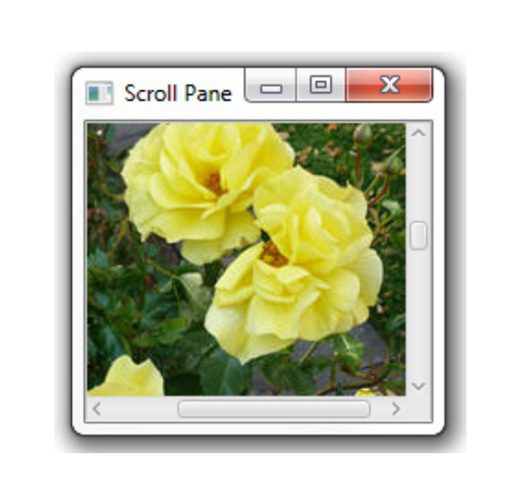
Scroll Pane
With the Scroll pane, you can add vertical and horizontal scroll bars into a window.
Image roses = new Image(getClass().getResourceAsStream("roses.jpg"));
ScrollPane sp = new ScrollPane();
sp.setContent(new ImageView(roses));

Slide 44
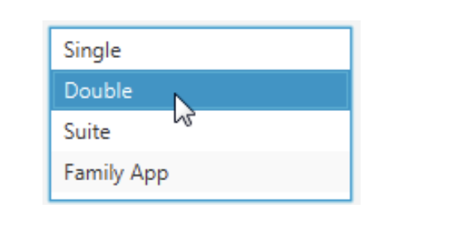
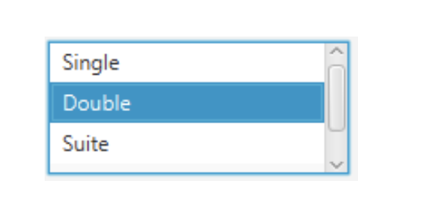
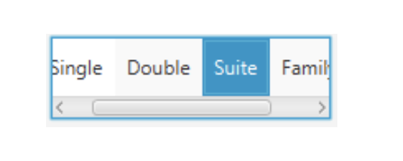
List View
You can select elements from the list with List view.

Slide 45
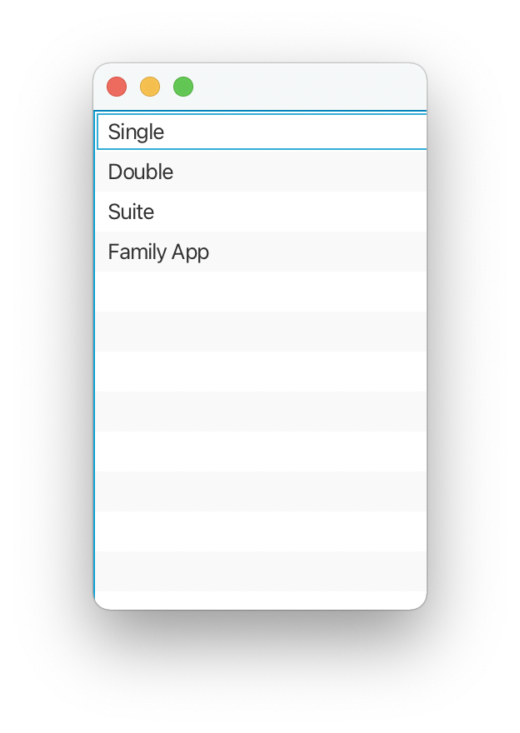
Visual Program Example - 10
Let’s implement a Visual program using List View.

Slide 46
List View Program
package com.example.kontrollerprj1;
import javafx.application.Application;
import javafx.collections.FXCollections;
import javafx.collections.ObservableList;
import javafx.scene.Scene;
import javafx.scene.control.*;
import javafx.scene.layout.AnchorPane;
import javafx.stage.Stage;
import java.io.IOException;
public class HelloApplication extends Application {
@Override
public void start(Stage stage) throws IOException {
AnchorPane root = new AnchorPane();
ListView <String> list = new ListView<>();
ObservableList<String> items = FXCollections.observableArrayList (
"Single", "Double", "Suite", "Family App");
list.setItems(items);
Scene scene = new Scene(root, 200,300);
root.getChildren().add(list);
stage.setScene(scene);
stage.show();
}
public static void main(String[] args) {
launch();
}
}

Slide 47
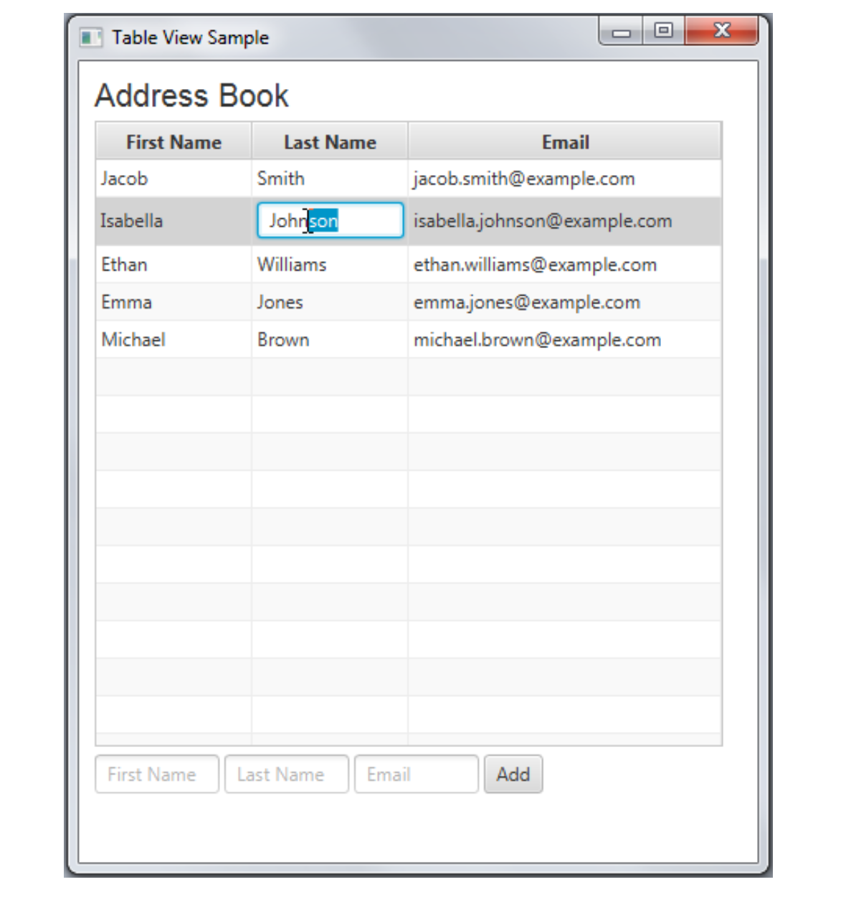
Table View
You can create tables with Table view.

Slide 48
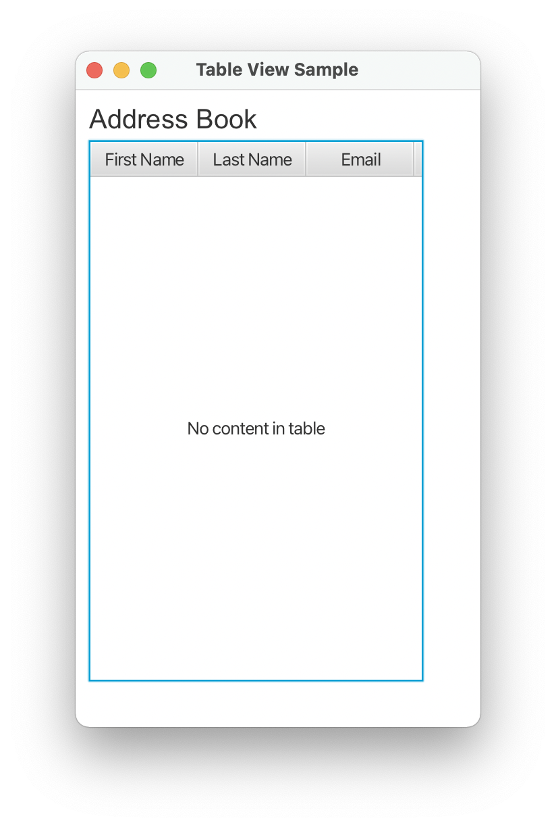
Visual Program Example - 11
Let's prepare a Visual program using Table View.

Slide 49
Table View Program
package com.example.kontrollerprj1;
import javafx.application.Application;
import javafx.collections.FXCollections;
import javafx.collections.ObservableList;
import javafx.geometry.Insets;
import javafx.scene.Group;
import javafx.scene.Scene;
import javafx.scene.control.*;
import javafx.scene.layout.AnchorPane;
import javafx.scene.layout.VBox;
import javafx.scene.text.Font;
import javafx.stage.Stage;
import java.io.IOException;
public class HelloApplication extends Application {
private final TableView table = new TableView();
@Override
public void start(Stage stage) throws IOException {
Scene scene = new Scene(new Group());
stage.setTitle("Table View Sample");
stage.setWidth(300);
stage.setHeight(500);
final Label label = new Label("Address Book");
label.setFont(new Font("Arial", 20));
table.setEditable(true);
TableColumn firstNameCol = new TableColumn("First Name");
TableColumn lastNameCol = new TableColumn("Last Name");
TableColumn emailCol = new TableColumn("Email");
table.getColumns().addAll(firstNameCol, lastNameCol, emailCol);
final VBox vbox = new VBox(); vbox.setSpacing(5);
vbox.setPadding(new Insets(10, 0, 0, 10));
vbox.getChildren().addAll(label, table);
((Group) scene.getRoot()).getChildren().addAll(vbox);
stage.setScene(scene);
stage.show();
}
public static void main(String[] args) {
launch();
}
}

Slide 50
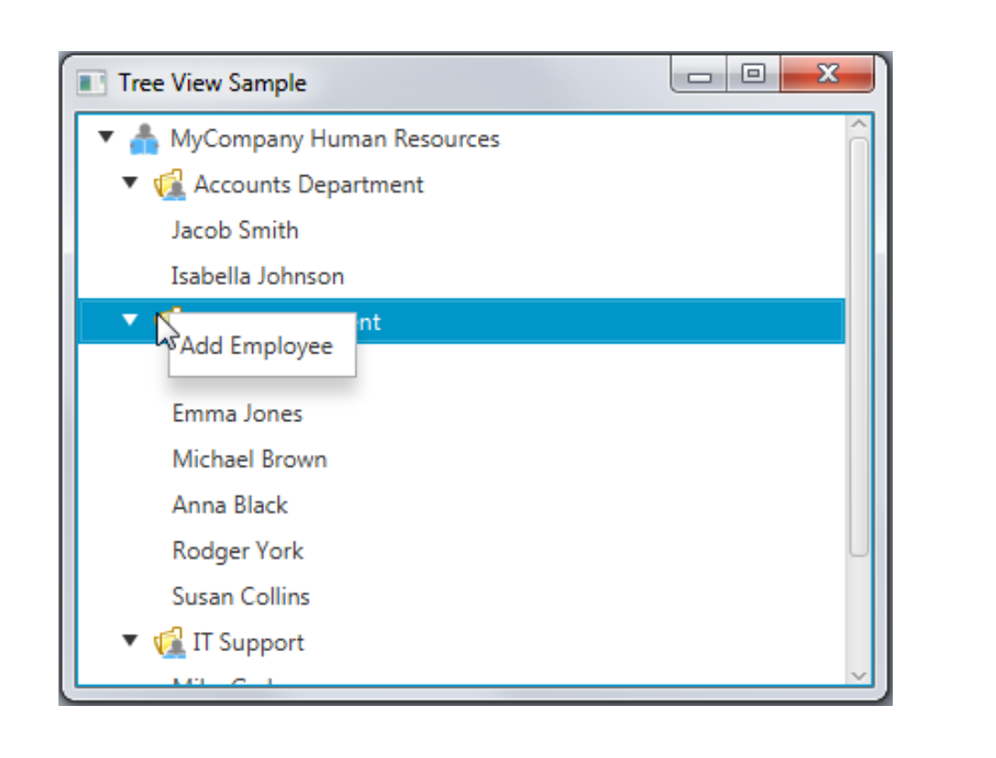
Tree View
You can create a hierarchy with Tree view.

Slide 51
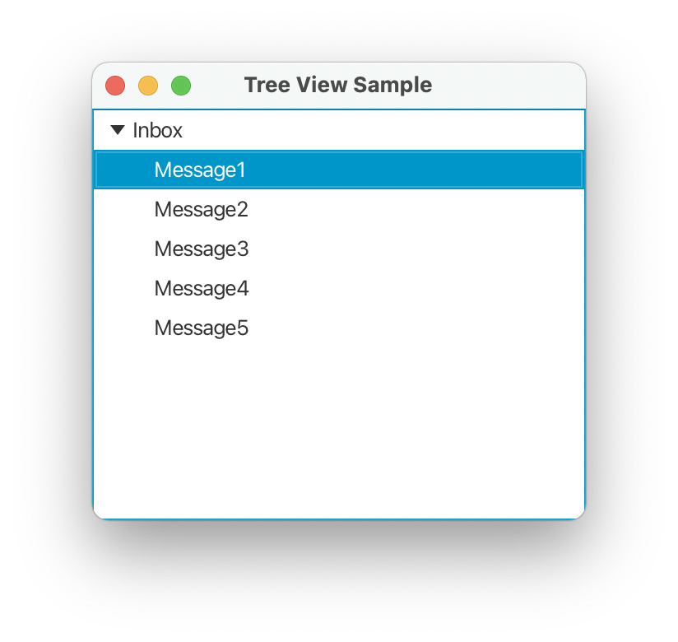
Visual Program Example - 12
Let’s implement a Visual program using Tree View.

Slide 52
Tree View Program
package com.example.kontrollerprj1;
import javafx.application.Application;
import javafx.collections.FXCollections;
import javafx.collections.ObservableList;
import javafx.geometry.Insets;
import javafx.scene.Group;
import javafx.scene.Scene;
import javafx.scene.control.*;
import javafx.scene.layout.AnchorPane;
import javafx.scene.layout.StackPane;
import javafx.scene.layout.VBox;
import javafx.scene.text.Font;
import javafx.stage.Stage;
import java.io.IOException;
public class HelloApplication extends Application {
private final TableView table = new TableView();
@Override
public void start(Stage stage) throws IOException {
stage.setTitle("Tree View Sample");
TreeItem<String> rootItem = new TreeItem<> ("Inbox");
rootItem.setExpanded(true);
for(int i=1;i<6;i++){
TreeItem<String> item = new TreeItem<> ("Message" + i);
rootItem.getChildren().add(item);
}
TreeView<String> tree = new TreeView<> (rootItem);
StackPane root = new StackPane();
root.getChildren().add(tree);
stage.setScene(new Scene(root, 300, 250));
stage.show();
}
public static void main(String[] args) {
launch();
}
}

Slide 53
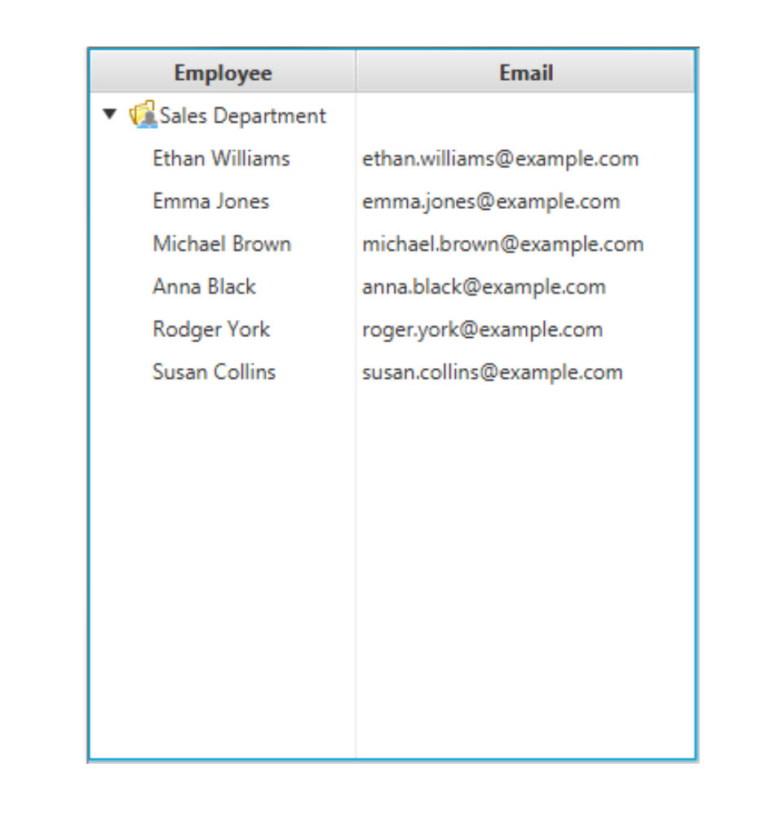
Tree Table View
You can create a hierarchy table with a tree table view.

Slide 54
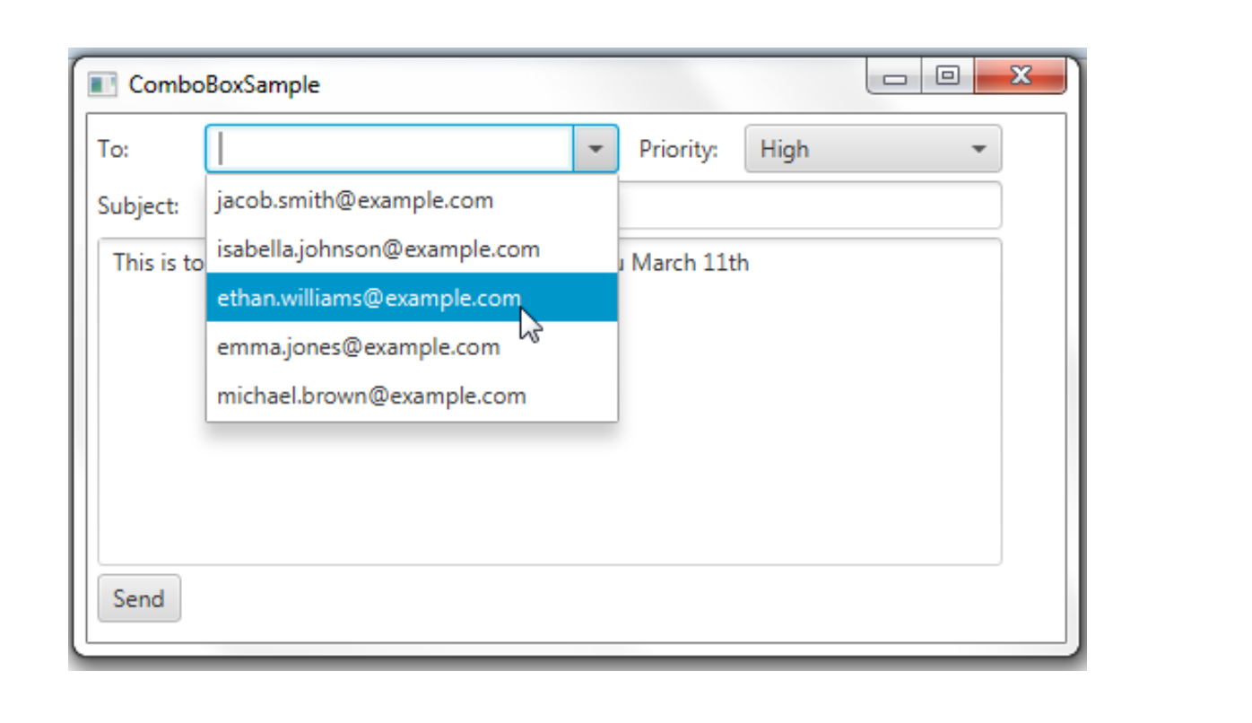
Combo Box
With a combo box, unlike a choice box, you can choose from a list with a scroll bar.

Slide 55
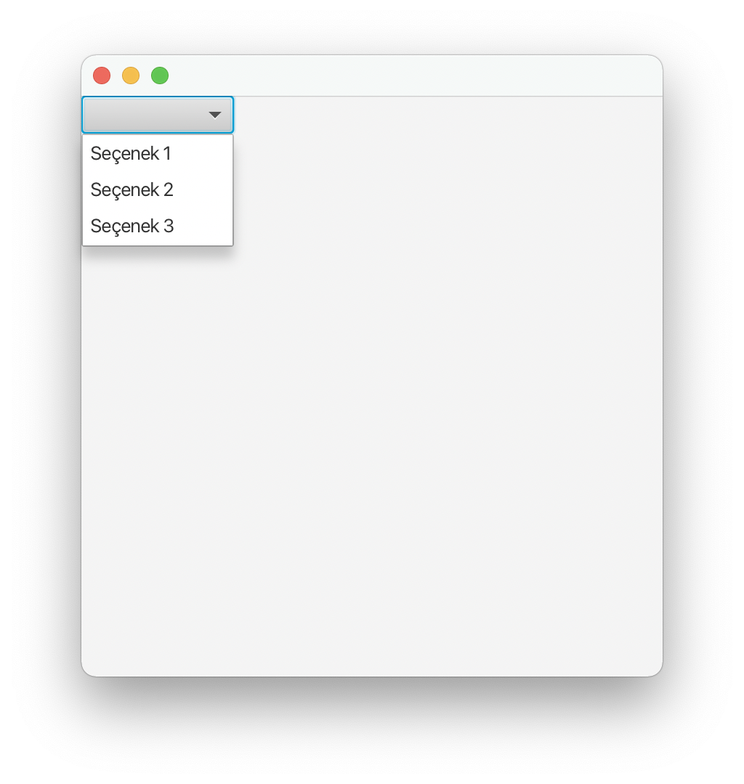
Visual Program Example - 13
Let’s implement a Visual program using a combo box.

Slide 56
Combo Box Program
package com.example.kontrollerprj1;
import javafx.application.Application;
import javafx.collections.FXCollections;
import javafx.collections.ObservableList;
import javafx.scene.Scene;
import javafx.scene.control.*;
import javafx.scene.layout.AnchorPane;
import javafx.stage.Stage;
import java.io.IOException;
public class HelloApplication extends Application {
private final TableView table = new TableView();
@Override
public void start(Stage stage) throws IOException {
ObservableList <String> opsiyonlar = FXCollections.observableArrayList("Seçenek 1", "Seçenek 2", "Seçenek 3");
ComboBox combo = new ComboBox(opsiyonlar);
AnchorPane root = new AnchorPane();
root.getChildren().add(combo);
Scene scene = new Scene(root, 400,400);
stage.setScene(scene);
stage.show();
}
public static void main(String[] args) {
launch();
}
}

Slide 57
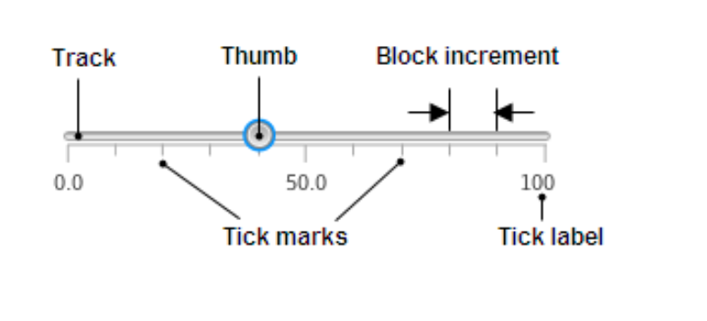
Slider
If you read data with the Slider, you can read it from a Visual scale instead of a numeric value.

Slide 58
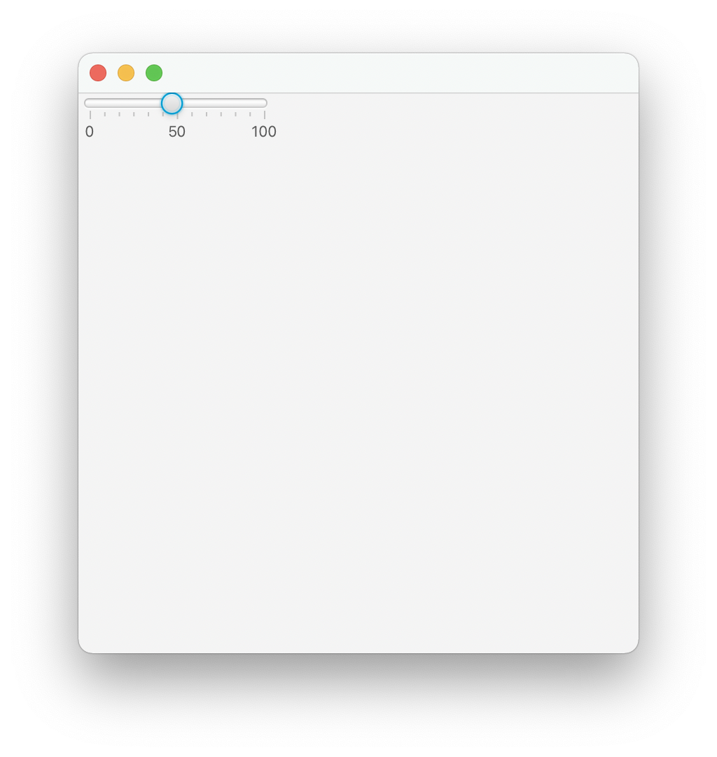
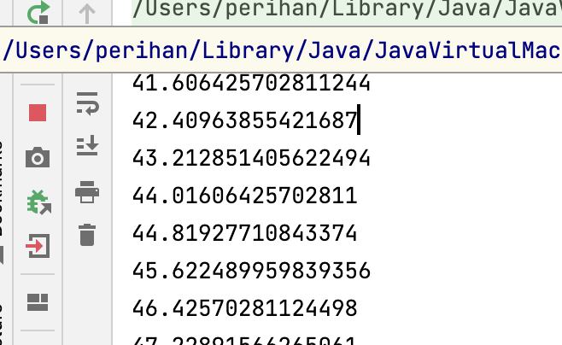
Visual Program Example - 14
Let’s implement a Visual program using the Slider. When the values in the Slider change, let's print it on the screen.

Slide 59
Slider Program
package com.example.kontrollerprj1;
import javafx.application.Application;
import javafx.beans.value.ObservableValue;
import javafx.scene.Scene;
import javafx.scene.control.*;
import javafx.scene.layout.AnchorPane;
import javafx.stage.Stage;
import java.io.IOException;
public class HelloApplication extends Application {
@Override
public void start(Stage stage) throws IOException {
Slider slider = new Slider();
slider.setMin(0);
slider.setMax(100);
slider.setValue(40);
slider.setShowTickLabels(true);
slider.setShowTickMarks(true);
slider.setMajorTickUnit(50);
slider.setMinorTickCount(5);
slider.setBlockIncrement(10);
AnchorPane root = new AnchorPane();
root.getChildren().add(slider);
Scene scene = new Scene(root, 400,400);
stage.setScene(scene);
slider.valueProperty().addListener((ObservableValue < ? extends Number> ov, Number old_value, Number new_value)->
{ System.out.println(slider.getValue());});
stage.show();
}
public static void main(String[] args) {
launch();
}
}

Slide 60
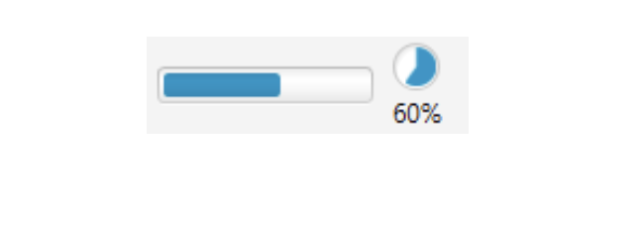
Progress Bar and Indicator
With the Progress Bar and Progress Indicator, you can tell you how much of the process is complete.
ProgressBar pb = new ProgressBar(0.6);
ProgressIndicator pi = new ProgressIndicator(0.6);

Slide 61
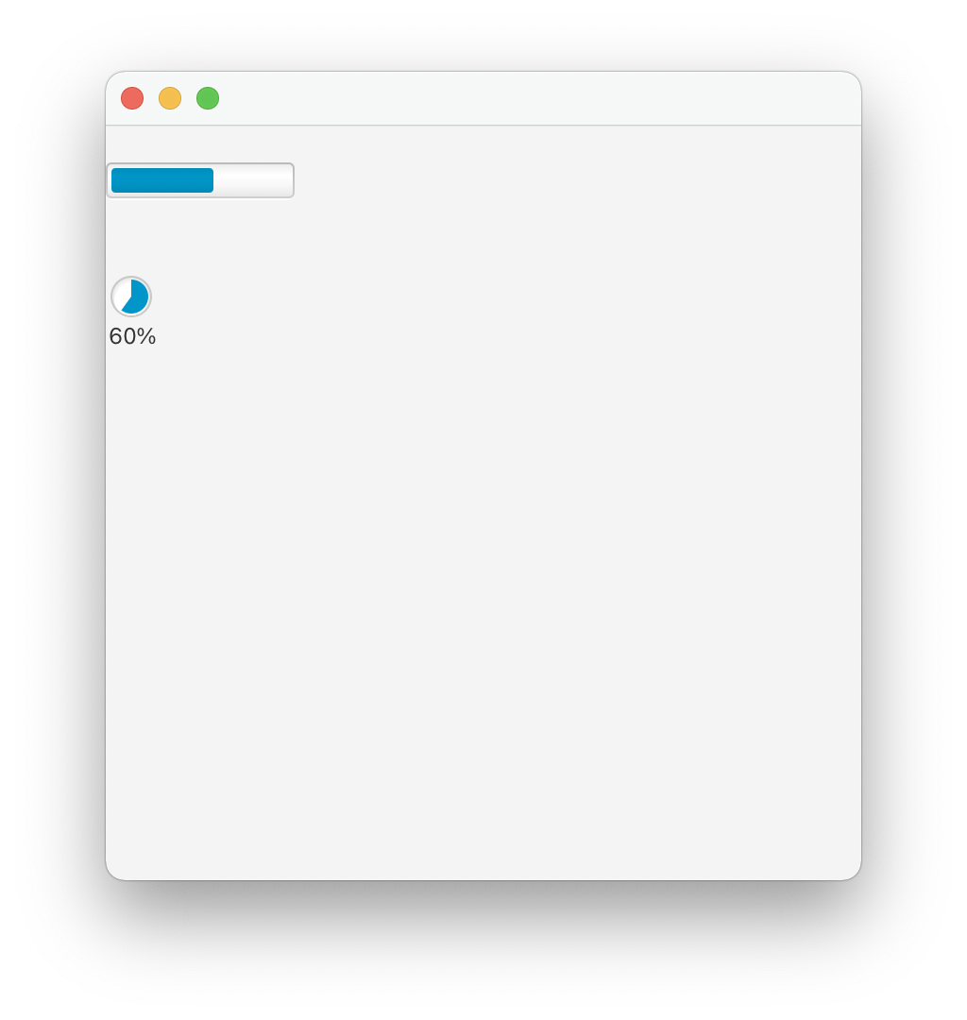
Visual Program Example - 15
Let’s implement a Visual program using the Progress Bar and Progress Indicator.

Slide 62
Progress Bar and Progress Indicator Program
package com.example.kontrollerprj1;
import javafx.application.Application;
import javafx.scene.Scene;
import javafx.scene.control.*;
import javafx.scene.layout.AnchorPane;
import javafx.stage.Stage;
import java.io.IOException;
public class HelloApplication extends Application {
@Override
public void start(Stage stage) throws IOException {
ProgressBar pb = new ProgressBar(0.6);
pb.setLayoutY(20);
ProgressIndicator pi = new ProgressIndicator(0.6);
pi.setLayoutY(80);
AnchorPane root = new AnchorPane();
root.getChildren().addAll(pb, pi);
Scene scene = new Scene(root, 400,400);
stage.setScene(scene);
stage.show();
}
public static void main(String[] args) {
launch();
}
}

Slide 63
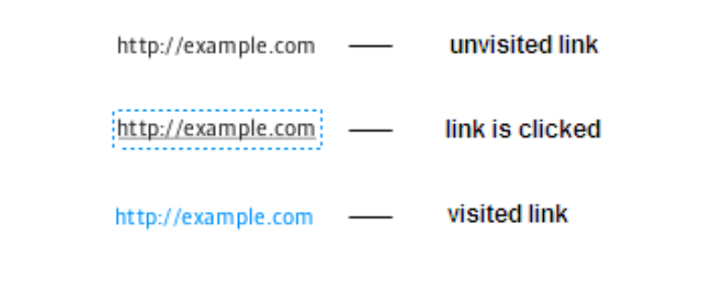
HyperLink
With HyperLink, you can link to web pages.

Slide 64
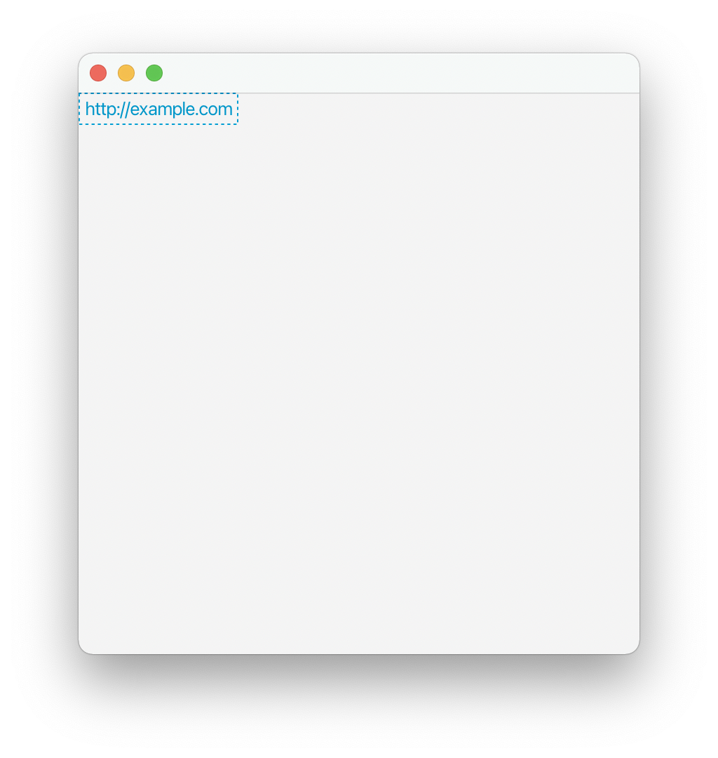
Visual Program Example - 16
Let’s implement a Visual program using HyperLink.

Slide 65
HyperLink Program
package com.example.kontrollerprj1;
import javafx.application.Application;
import javafx.event.ActionEvent;
import javafx.scene.Scene;
import javafx.scene.control.*;
import javafx.scene.layout.AnchorPane;
import javafx.stage.Stage;
import java.io.IOException;
public class HelloApplication extends Application {
@Override
public void start(Stage stage) throws IOException {
Hyperlink link = new Hyperlink();
link.setText("http://example.com");
link.setOnAction((ActionEvent e) -> {
System.out.println("This link is clicked"); });
AnchorPane root = new AnchorPane();
root.getChildren().add(link);
Scene scene = new Scene(root, 400,400);
stage.setScene(scene);
stage.show();
}
public static void main(String[] args) {
launch();
}
}

Slide 66
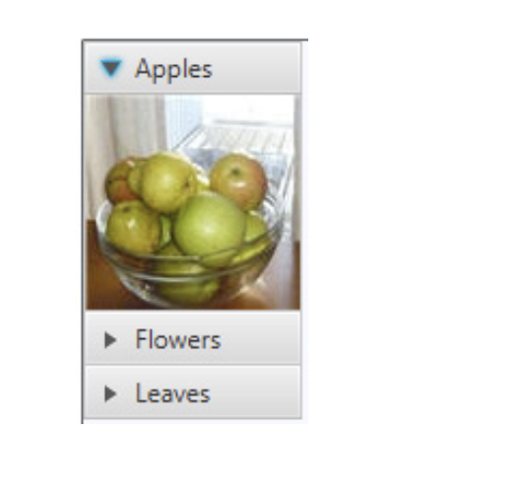
Titled Pane and Accordion
You can use multiple panes with Titled Pane and Accordion.

Slide 67
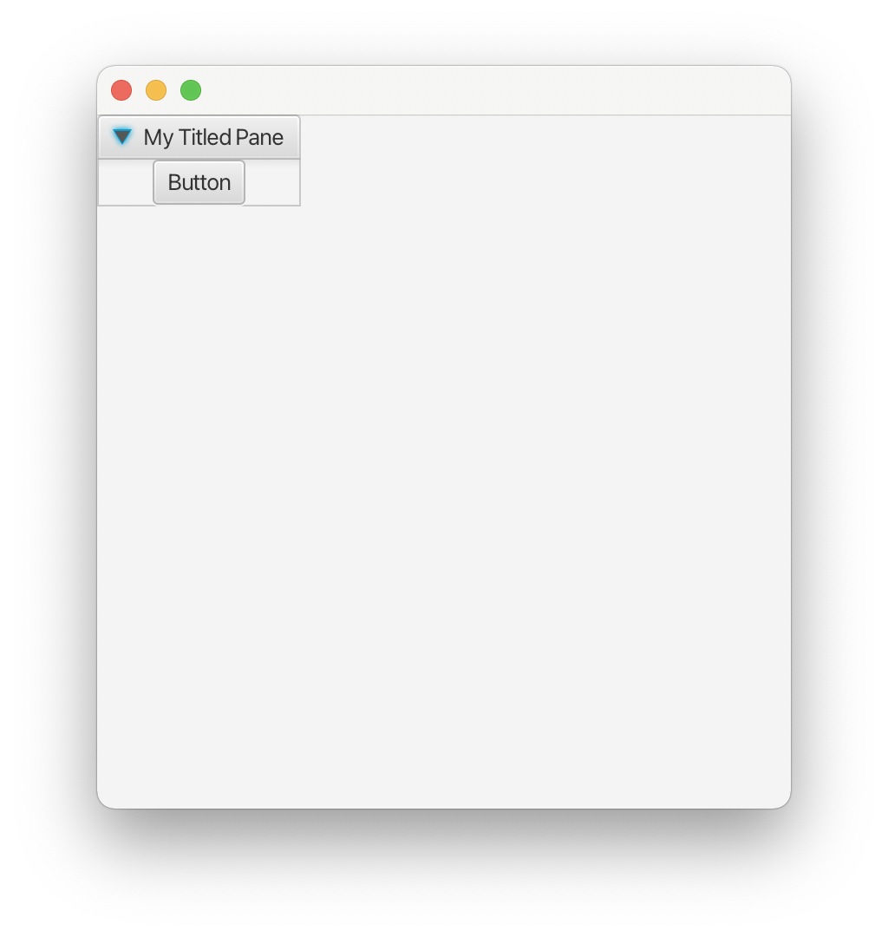
Visual Program Example - 17
Let’s implement a Visual program using the Titled pane.

Slide 68
Titled Pane Program
package com.example.kontrollerprj1;
import javafx.application.Application;
import javafx.scene.Scene;
import javafx.scene.control.*;
import javafx.scene.layout.AnchorPane;
import javafx.stage.Stage;
import java.io.IOException;
public class HelloApplication extends Application {
@Override
public void start(Stage stage) throws IOException {
TitledPane tp = new TitledPane();
tp.setText("My Titled Pane");
tp.setContent(new Button("Button"));
AnchorPane root = new AnchorPane();
root.getChildren().add(tp);
Scene scene = new Scene(root, 400,400);
stage.setScene(scene);
stage.show();
}
public static void main(String[] args) {
launch();
}
}

Slide 69
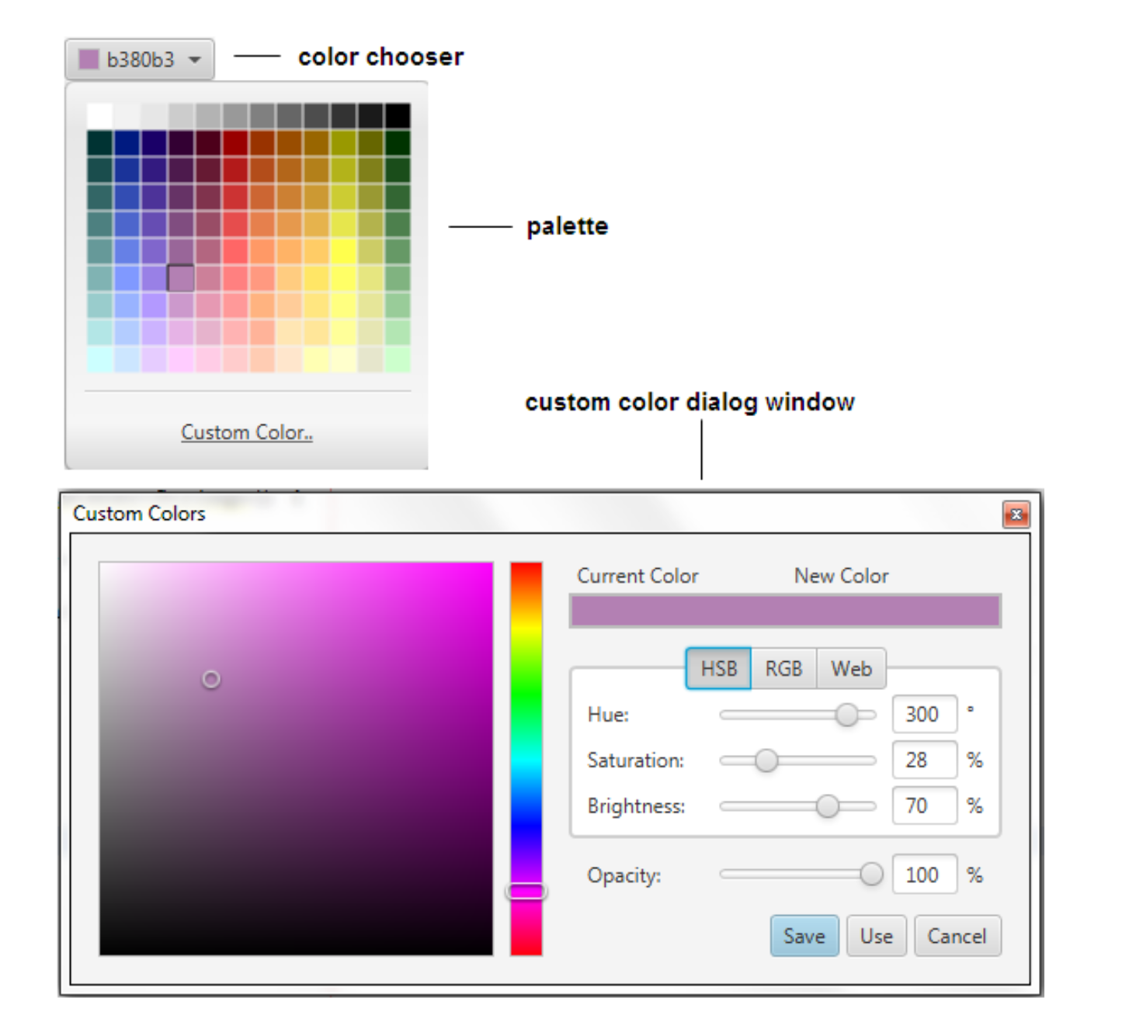
Color Picker
You can choose colors with Color Picker.
//Empty contructor, the control appears with the default color,
//which is WHITE ColorPicker
colorPicker1 = new ColorPicker();
//Color constant set as the currently selected color
ColorPicker colorPicker2 = new ColorPicker(Color.BLUE);
//Web color value set as the currently selected color ColorPicker
colorPicker3 = new ColorPicker(Color.web("#ffcce6"));

Slide 70
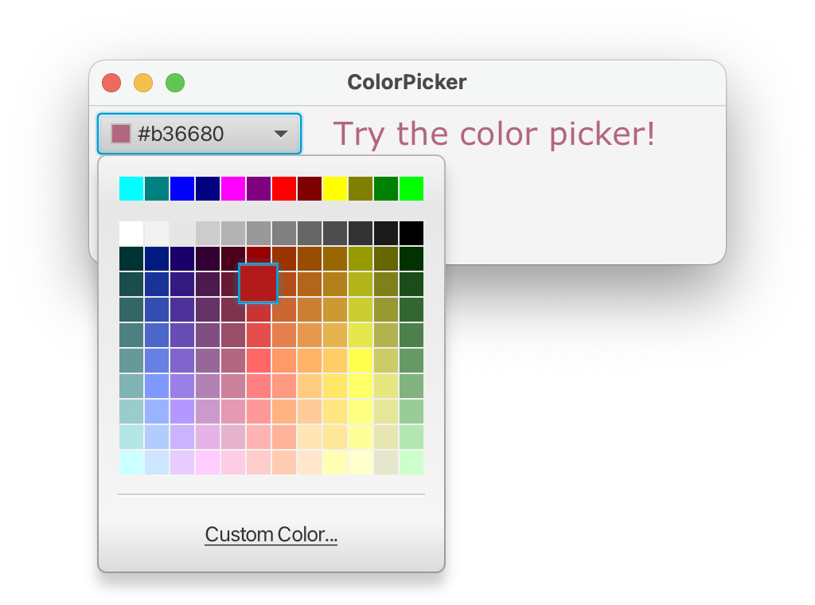
Visual Program Example - 18
Let’s implement a Visual program using the color picker.

Slide 71
Color Picker Program
package com.example.kontrollerprj1;
import javafx.application.Application;
import javafx.event.ActionEvent;
import javafx.geometry.Insets;
import javafx.scene.Scene;
import javafx.scene.control.*;
import javafx.scene.layout.AnchorPane;
import javafx.scene.layout.HBox;
import javafx.scene.paint.Color;
import javafx.scene.text.Font;
import javafx.scene.text.Text;
import javafx.stage.Stage;
import java.io.IOException;
public class HelloApplication extends Application {
@Override
public void start(Stage stage) throws IOException {
stage.setTitle("ColorPicker");
Scene scene = new Scene(new HBox(20), 400, 100);
HBox box = (HBox) scene.getRoot();
box.setPadding(new Insets(5, 5, 5, 5));
ColorPicker colorPicker = new ColorPicker();
colorPicker.setValue(Color.CORAL);
Text text = new Text("Try the color picker!");
text.setFont(Font.font ("Verdana", 20));
text.setFill(colorPicker.getValue());
colorPicker.setOnAction((ActionEvent t) -> { text.setFill(colorPicker.getValue());
});
box.getChildren().addAll(colorPicker, text);
stage.setScene(scene);
stage.show();
}
public static void main(String[] args) {
launch();
}
}

Slide 72
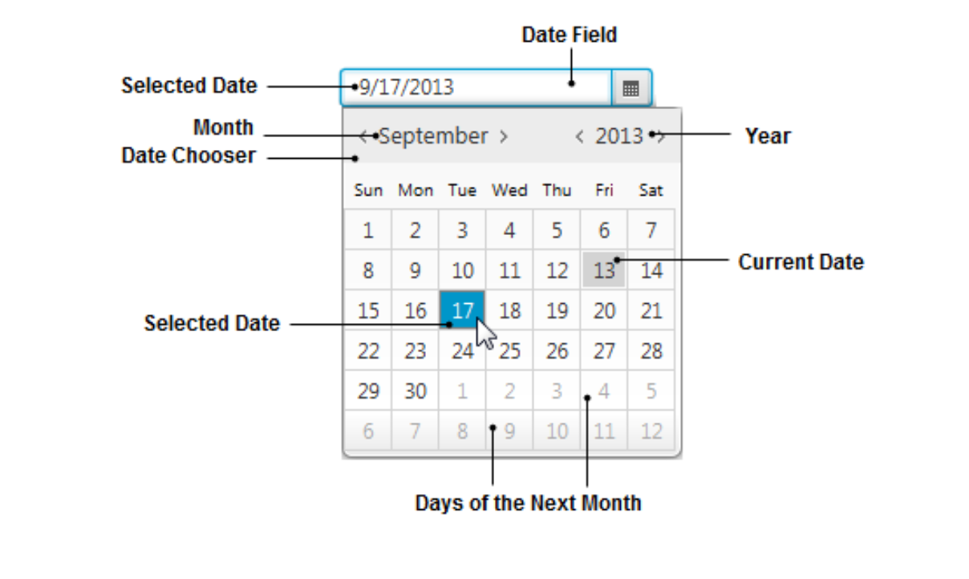
Date Picker
You can make a date selection with Date Picker.

Slide 73
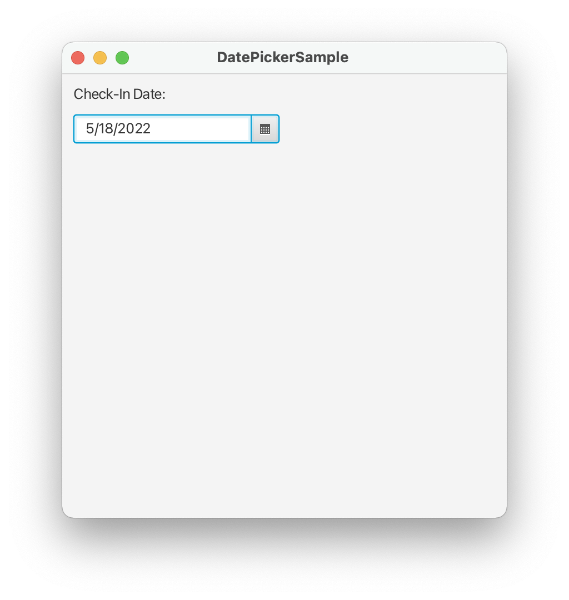
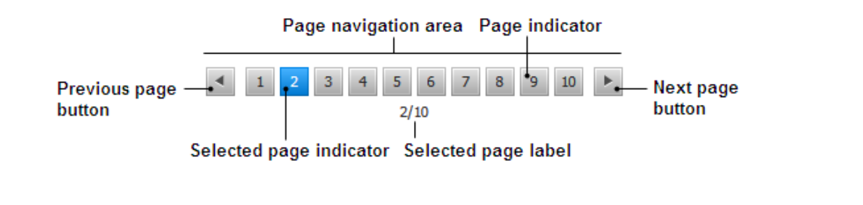
Visual Program Example - 19
Let’s implement a Visual program using the date picker.

Slide 74
Date Picker Program
package com.example.kontrollerprj1;
import javafx.application.Application;
import javafx.geometry.HPos;
import javafx.scene.Scene;
import javafx.scene.control.*;
import javafx.scene.layout.GridPane;
import javafx.scene.layout.VBox;
import javafx.stage.Stage;
import java.io.IOException;
import java.util.Locale;
public class HelloApplication extends Application {
@Override
public void start(Stage stage) throws IOException {
Locale.setDefault(Locale.US);
stage.setTitle("DatePickerSample ");
VBox vbox = new VBox(20);
vbox.setStyle("-fx-padding: 10;");
Scene scene = new Scene(vbox, 400, 400);
stage.setScene(scene);
DatePicker checkInDatePicker= new DatePicker();
GridPane gridPane = new GridPane();
gridPane.setHgap(10);
gridPane.setVgap(10);
Label checkInlabel = new Label("Check-In Date:");
gridPane.add(checkInlabel, 0, 0);
GridPane.setHalignment(checkInlabel, HPos.LEFT);
gridPane.add(checkInDatePicker, 0, 1);
vbox.getChildren().add(gridPane);
stage.setScene(scene);
stage.show();
}
public static void main(String[] args) {
launch();
}
}

Slide 75
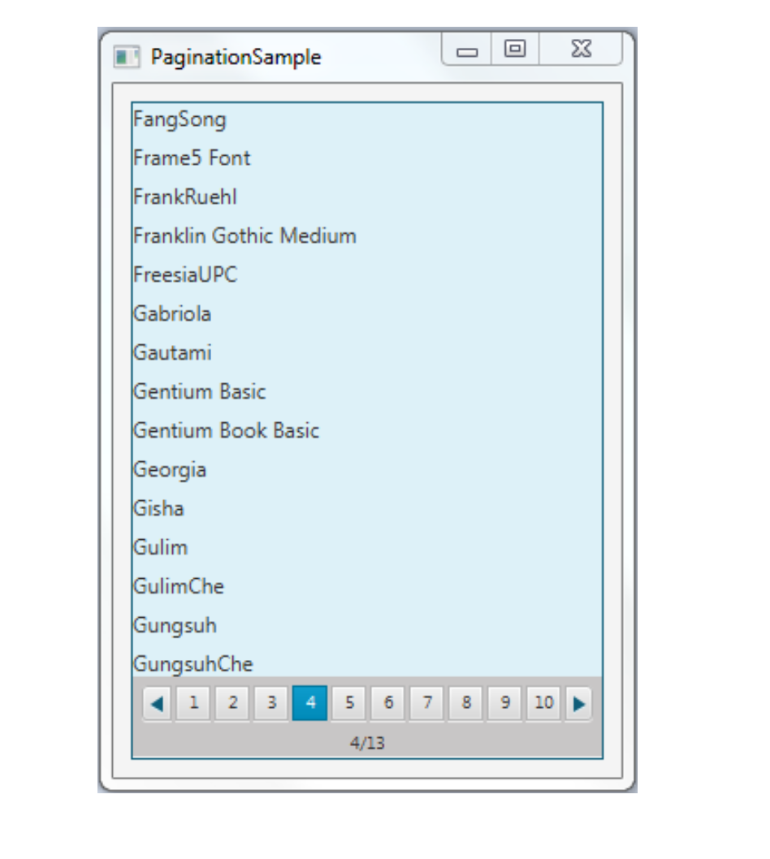
Pagination Control
You can make page selection with Pagination Control.
//Creates a Pagination control with an INDETERMINATE page count
//and the current page index equal to zero
Pagination pagination1 = new Pagination();
//Creates a Pagination control with 5 pages
//and the current page index equal to zero
Pagination pagination2 = new Pagination(5);
//Creates a Pagination control with 5 pages
// and the current selected index equal to 2 Pagination
pagination3 = new Pagination(5, 2)

Slide 76

Visual Program Example - 20
Let’s implement a Visual program using Pagination Control.

Slide 77
Pagination Control Program
package com.example.kontrollerprj1;
import javafx.application.Application;
import javafx.geometry.HPos;
import javafx.scene.Scene;
import javafx.scene.control.*;
import javafx.scene.layout.AnchorPane;
import javafx.scene.layout.GridPane;
import javafx.scene.layout.VBox;
import javafx.stage.Stage;
import java.io.IOException;
import java.util.Locale;
public class HelloApplication extends Application {
@Override
public void start(Stage stage) throws IOException {
Pagination pagination1 = new Pagination(5,2);
AnchorPane root =new AnchorPane();
Scene scene = new Scene(root);
root.getChildren().add(pagination1);
stage.setScene(scene);
stage.show();
}
public static void main(String[] args) {
launch();
}
}

Slide 78

File Chooser
You can make file selection with File Chooser.

Slide 79

Visual Program Example - 21
Implement a program according to the screenshot below.

Slide 80
Text Program
package com.example.cokyazi;
import javafx.application.Application;
import javafx.fxml.FXMLLoader;
import javafx.scene.Group;
import javafx.scene.Scene;
import javafx.scene.paint.Color;
import javafx.scene.text.Text;
import javafx.stage.Stage;
import java.io.IOException;
import java.util.Random;
public class HelloApplication extends Application {
@Override
public void start(Stage primaryStage) throws IOException {
primaryStage.setTitle("Text Programı");
Group root = new Group();
Scene scene = new Scene(root, 300, 250, Color.WHITE);
Random rand = new Random();
for (int i = 0; i < 100; i++) {
int x = rand.nextInt((int) scene.getWidth());
int y = rand.nextInt((int) scene.getHeight());
int red = rand.nextInt(255);
int green = rand.nextInt(255);
int blue = rand.nextInt(255);
Text text = new Text(x, y, "Visual Programlama");
int rot = rand.nextInt(360);
text.setFill(Color.rgb(red, green, blue, .99));
text.setRotate(rot);
root.getChildren().add(text);
}
primaryStage.setScene(scene);
primaryStage.show();
}
public static void main(String[] args) {
launch();
}
}

Slide 81
JavaFX Scene Builder

Slide 82

Visual Program, Check box Example - 22
Implement the program according to the screenshot below.

Slide 83
Visual Program Example - 22
package com.example.demo5;
import javafx.application.Application;
import javafx.fxml.FXMLLoader;
import javafx.scene.Scene;
import javafx.stage.Stage;
import java.io.IOException;
public class HelloApplication extends Application {
@Override
public void start(Stage stage) throws IOException {
FXMLLoader fxmlLoader = new FXMLLoader(HelloApplication.class.getResource("hello-view.fxml"));
Scene scene = new Scene(fxmlLoader.load(), 320, 240);
stage.setTitle("Kontroller!");
stage.setScene(scene);
stage.show();
}
public static void main(String[] args) {
launch();
}
}

Slide 84
Visual Program Example - 22
package com.example.demo5;
import javafx.fxml.FXML;
import javafx.scene.control.CheckBox;
import javafx.scene.control.ComboBox;
import javafx.scene.control.Label;
public class HelloController {
@FXML
private Label welcomeText;
@FXML
private CheckBox myCheckBox;
@FXML
private Label myLabel;
@FXML
protected void comboTikla() {
if (myCheckBox.isSelected())
myLabel.setText("Evet!");
else
myLabel.setText("Hayır");
}
}

Slide 85


Visual Program, Radio button Example - 23
Implement a program according to the screenshot below.

Slide 86
Visual Program Example - 23
package com.example.demo5;
import javafx.application.Application;
import javafx.fxml.FXMLLoader;
import javafx.scene.Scene;
import javafx.stage.Stage;
import java.io.IOException;
public class HelloApplication extends Application {
@Override
public void start(Stage stage) throws IOException {
FXMLLoader fxmlLoader = new FXMLLoader(HelloApplication.class.getResource("hello-view.fxml"));
Scene scene = new Scene(fxmlLoader.load(), 320, 240);
stage.setTitle("Kontroller!");
stage.setScene(scene);
stage.show();
}
public static void main(String[] args) {
launch();
}
}

Slide 87
Visual Program Example - 23
package com.example.demo5;
import javafx.fxml.FXML;
import javafx.scene.control.CheckBox;
import javafx.scene.control.ComboBox;
import javafx.scene.control.Label;
import javafx.scene.control.RadioButton;
public class HelloController {
@FXML
private RadioButton muzik, beden, satranc;
@FXML
private Label myLabel;
@FXML
protected void radioTikla() {
if (muzik.isSelected())
myLabel.setText("Müzik");
else if (beden.isSelected())
myLabel.setText("Beden");
else if (satranc.isSelected())
myLabel.setText("Satranç");
}
}

Slide 88

Visual Program, DatePicker Example - 24
Implement a program according to the screenshot below.

Slide 89
Visual Program Example - 24
package com.example.demo5;
import javafx.application.Application;
import javafx.fxml.FXMLLoader;
import javafx.scene.Scene;
import javafx.stage.Stage;
import java.io.IOException;
public class HelloApplication extends Application {
@Override
public void start(Stage stage) throws IOException {
FXMLLoader fxmlLoader = new FXMLLoader(HelloApplication.class.getResource("hello-view.fxml"));
Scene scene = new Scene(fxmlLoader.load(), 320, 240);
stage.setTitle("Kontroller!");
stage.setScene(scene);
stage.show();
}
public static void main(String[] args) {
launch();
}
}

Slide 90
Visual Program Example - 24
package com.example.demo5;
import javafx.fxml.FXML;
import javafx.scene.control.*;
import java.time.LocalDate;
import java.time.format.DateTimeFormatter;
import java.util.Formatter;
public class HelloController {
@FXML
private DatePicker myDate;
@FXML
private Label myLabel;
@FXML
protected void tarihTikla() {
LocalDate tarih = myDate.getValue();
String formatliTarih = tarih.format(DateTimeFormatter.ofPattern("dd-MMM-yyyy"));
myLabel.setText(formatliTarih);
}
}

Slide 91

Visual Program, ColorPicker Example - 25
Implement a program according to the screenshot below.

Slide 92
Visual Program Example - 25
package com.example.demo5;
import javafx.application.Application;
import javafx.fxml.FXMLLoader;
import javafx.scene.Scene;
import javafx.stage.Stage;
import java.io.IOException;
public class HelloApplication extends Application {
@Override
public void start(Stage stage) throws IOException {
FXMLLoader fxmlLoader = new FXMLLoader(HelloApplication.class.getResource("hello-view.fxml"));
Scene scene = new Scene(fxmlLoader.load());
stage.setTitle("Kontroller!");
stage.setScene(scene);
stage.show();
}
public static void main(String[] args) {
launch();
}
}

Slide 93
Visual Program Example - 25
package com.example.demo5;
import javafx.event.ActionEvent;
import javafx.fxml.FXML;
import javafx.scene.control.*;
import javafx.scene.layout.Background;
import javafx.scene.layout.BackgroundFill;
import javafx.scene.layout.Pane;
import javafx.scene.paint.Color;
import java.time.LocalDate;
import java.time.format.DateTimeFormatter;
import java.util.Formatter;
public class HelloController {
@FXML
private Pane myPane;
@FXML
private ColorPicker myColor;
@FXML
protected void renkTikla(ActionEvent e) {
Color renk = myColor.getValue();
myPane.setBackground(new Background(new BackgroundFill(renk,null,null)));
}
}

Slide 94

Homework - 1
Make examples on RadioButton and Combobox.

Slide 95
Next Lecture
We will investigate the answer to the question of how to add a menu to a visual program.

Slide 96
Summary
We learned on the user controls.
Next week we'll learn how to use the menu and continue with example apps. Come to class prepared.

